Slide 1
Silver Linings for High-Risk Infants: Coordinated Medical, Legal, and Developmental Services from 0-6 Years s
Lea Redd, BA
Bree Andrews, MD, MPH and Brianne Dotts, JD

Slide 2
Background
NICU graduates have extensive medical, developmental, and social needs
Medical Complexities include:
BPD
G-tube
Tracheostomy
VP shunt
Developmental Delays include:
ADD, ADHD, Autism Spectrum and other intellectual impairments
Cerebral Palsy and other motor delays
Need for glasses and hearing aids
1.

Slide 3
ENVIRONMENT
SELF WORTH
PREGNANCY
RISK FACTORS
POTENTIAL OUTCOMES
NEWBORN INFANT
Poverty
Poor community support
Poor health services
Poor education
Despair
Substance abuse
Promiscuity
Limited prenatal care
Tobacco, alcohol & drug use
Risk of STD’s/HIV
Prematurity
Low birth weight
Fetal Alcohol Syndrome
Infant with increased needs
Medical needs
Developmental needs
Increased irritability
Increased demands
Lack of supports
Substance abuse
Health concerns
Neurodevelopmental disabilities
Child neglect and abuse
Foster care placement
Mother under stress
CYCLE OF DISADVANTAGE AND DISABILITY

Slide 4
Goal: Evaluate coordinated legal advocacy to improve access to public benefits for medically complex children who come from low income, minority families
These children are at increased risk of having adverse health outcomes

Slide 5
Medical-Legal Partnerships (MLP)
Social determinants of health
Health is modified by illness, chronic disease, access to healthcare, access to pubic benefits
Lawyers are sometimes the best subspecialists
Understanding of health-related law: insurance, public benefits, housing, developmental and educational supports through IDEA

Slide 6
Early Steps
Project Access, a MLP project at the University of Chicago from 2000-2004
3-5 unmet legal needs at NICU discharge
Most needs around public benefits
Established the Chicago Medical-Legal Partnership for Children permanently in 2006
Previously: use ‘rescue’ legal services
Break the Cycle: Anticipate and introduce legal advocates earlier
1.
Notes:
randomized patients to usual case management and case management plus legal care

Slide 7
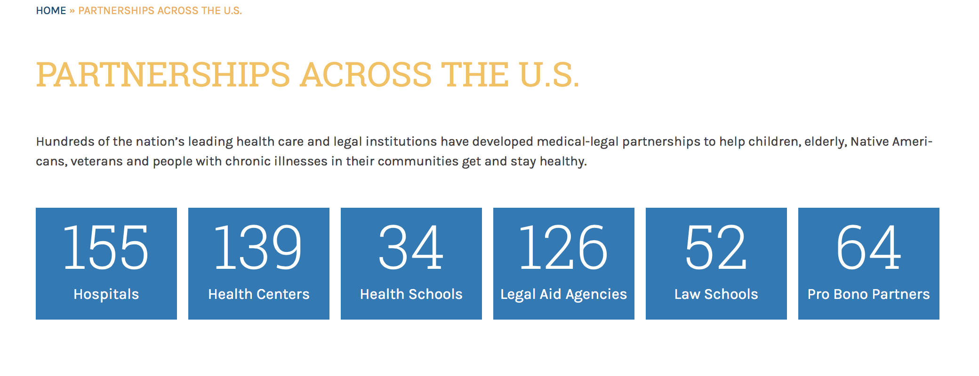
Medical-Legal Partnerships

Slide 8
Cartoon courtesy of Jack Maypole, MD (jackmaypole@yahoo.com)

Slide 9
Hypothesis
Improving the process of obtaining public benefits improves functional outcomes of children and parents
Using advocacy allows families to receive services earlier and more efficiently than if families have to navigate the system on their own
Notes:
Public Benefit processes are complex
MLP can help families access public benefits

Slide 10
Contact information given
Early Intervention contacted
Local School contacted
IFSP created
IEP created
SSI applications
Representation for benefits
Implementation of benefits
Methods Overview
100 families with complex medical
29 families offered MLP legal services
25 families consented for IRB approved study
Medical and Legal Care
Action Plan Created

Slide 11
Contact information given
Early Intervention contacted
Local School contacted
IFSP created
IEP created
SSI applications
Representation for benefits
Implementation of benefits
Methods Overview
100 families with complex medical needs
25 families consented for IRB approved study at regular doctor’s visit
Medical and Legal Care
29 families offered MLP legal services
Action Plan Created
PDH WIDEA-FS
Exit Interviews
Action Plan Reviewed

Slide 12
Results
Patient Population: | Pre-Term Infants (n=21) | Term Infants (n=4)
Mean NICU LOS: | 100 days | 60 days
Mean BW: | 820 grams | 2650 grams
Mean GA (weeks): | 26 wks ± 1.7 wks | 36 wks ± 2.5 wks
Male : Female | 13:8 | 3:1
Mean age at enrollment: | 3.3 yrs / 39 months | 2.4 yrs / 29 months
Income / % of Poverty | $1470 / 80 % | $1820 / 92 %
Extent of Delays
Bayley III Scores at 2 years were 75-90 for one domain: cognitive, motor, and speech
Extent of Medical Problems
Mean NICU stay was 120 days, with at least 3 NICU morbidities before discharge (BPD, ROP, feeding delays)
* One patient died before study completion

Slide 13
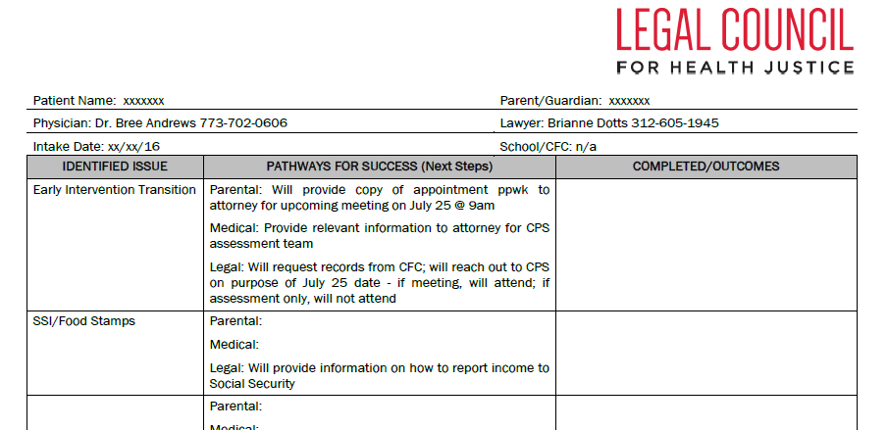
Action Items
Action Items Range: 2 - 6 items per child
80% items accomplished by parents, physicians, lawyers
6 out of 25 families have had legal representation in IEP meetings
Notes:
On average action items generated 3-6 contact points with lawyers between either parents---lawyers, lawyers---doctors, parents---public benefits.

Slide 14
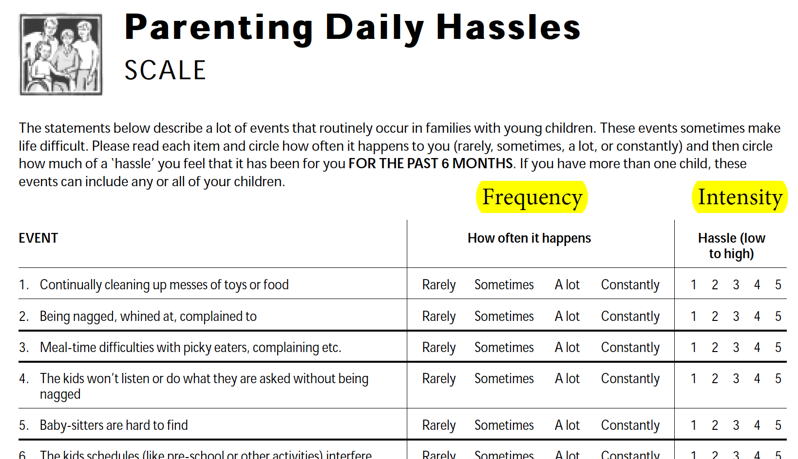
1 2 3 4
Mean Frequency and Intensity score: 2
Above average frequency mean (scored 3 – 4 in any event): 6
Notes:
Questionnaire lists 20 routinely occurring events in families with young children. Each event can be scored based on how often it happens (the frequency), and then when it does happen, how much of a problem it becomes (the intensity). If a parent identifies any event with a frequency of 3-4, then the event is happening with above average frequency. If an event is scored with an intensity of 4-5, then it indicates a significant problem for the parent. At the time of consent, parents identified an average of 6 out of 20 events with a high frequency.

Slide 15
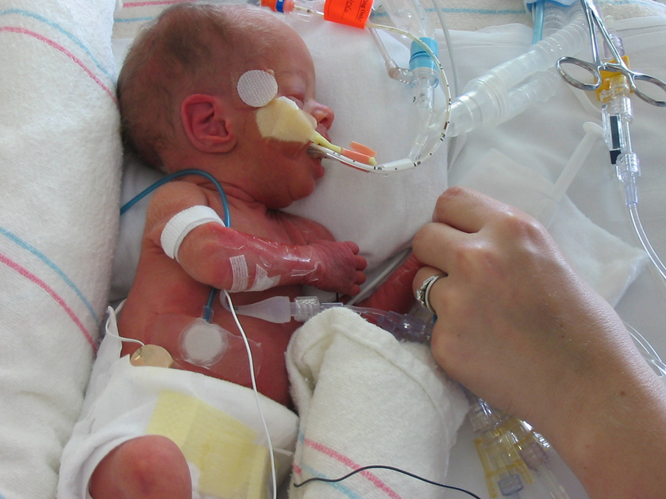
WIDEA FS
Functional skills were on average of 6-12 months behind for current age
Despite the functional scale being designed for children < 42 months, few patients had scores of 190-200(top of the scoring scale) despite many being over 42 months

Slide 16
Qualitative Results
Six interviews after legal action plan and legal intervention:
When asked about how well one parent now understands the special education system:
“I am more confident and willing to ask questions.”
“It’s very convenient and helpful to have the legal experts at the doctor’s office.”
Notes:
[now identifies both the physician and legal team as her advocates]
[and staff realize how to use lawyers to write compelling letters, forms, requests on behalf of parents/children]

Slide 17
Impact
Most clinics cannot offer legal counsel to families
Funding
Logistics
Action plans help families move forward in difficult processes related to public benefits, improving family functioning
Almost all processes could be deconstructed effectively
Typed document with action plan, resources, phone numbers, and contact points was feasible and helpful

Slide 18
Limitations
A functional scale that adapts as children age past 42 months might have been more helpful than the WIDEA-FS
The Action Plan process is one part of the larger roadmap to success
Needs in the NICU follow up population were very high
Only short term outcomes are currently available

Slide 19
Discussion
How can this process be taught?
Other clinics, outside of NICU care, can benefit
How do most clinicians obtain legal counsel for patients when needed?
Should it be the standard of care?
Notes:
Legal Aid Services are often available to patients outside of MLPs
How to disseminate Action Plan process

Slide 20
References
http://legalcouncil.org/cmlpc/
http://legalcouncil.org/wp-content/uploads/2015/01/Project_Access_Final_Report.pdf
Notes:
Legal Aid Services are often available to patients outside of MLPs
How to disseminate Action Plan process

