Slide 1
BREAK THE CYCLE 12 CONFERENCE
RECENT DDT EXPOSURE AND NEURODEVELOPMENTAL OUTCOMES IN CHILDREN OF SELECTED COMMUNITIES IN ZAMBIA
Student: NOSIKU MUNYINDA
Supervisor: CHARLES MICHELO, PROFESSOR

Slide 2
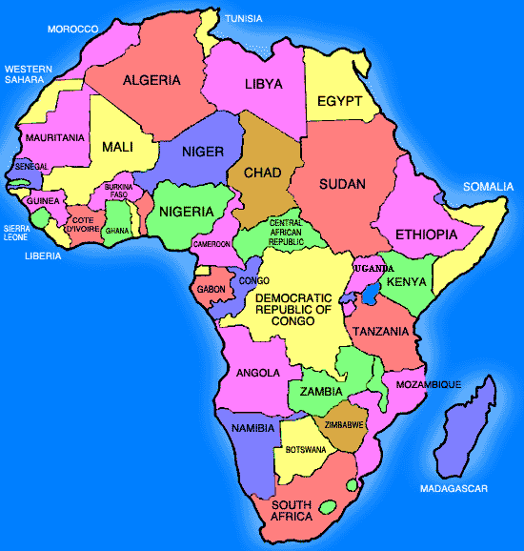

Slide 3
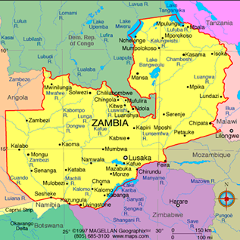
Zambia
Total population (thousands) 2012 | 14,075.1
Annual no. of births (thousands) 2012 | 608
Annual no. of under-5 deaths (thousands) 2012 | 50
GNI per capita (US$) 2012 | 1,350
Life expectancy at birth (years) 2012 | 57
Total adult literacy rate (%) 2008-2012* | 61.4
Primary school net enrolment ratio (%) 2008-2011* | 97.2
Infant mortality rate (under 1), 2012 56

Slide 4
Background
Malaria is still a leading cause of death and hospital admissions in Zambia
Mostly affected are pregnant women and children
To address this, the Ministry of Health in Zambia put into place an Integrated Vector Management (IVM) strategy which includes Indoor Residual House Spray with DDT among other chemicals

Slide 5
Background (2)
DDT is a Persistent Organic Pollutant with lipophilic, biomagnification and accumulation properties
Banned for use in the developed world since 1970
In 2000, listed under the Stockholm Convention for elimination except for use for malaria control in some developing countries including Zambia

Slide 6
General Objective
Specific objectives are:
To quantify recent DDT exposure and study neurodevelopment outcomes in children of selected communities in Zambia
2. To evaluate local social, economic and environmental conditions associated with the observed outcomes
3. To determine Neurodevelopmental outcomes in the targeted populations
1. To establish the prevalence of DDT in selected communities

Slide 8
To determine neurodevelopmental outcomes in the targeted populations

Slide 9
Neurodevelopmental Assessment
Neurodevelopmental outcomes
Covariates
Gross Motor functions
Fine Motor functions
Problem Solving
functions
Personal Social Functions
Communication
DDT exposure

Slide 10
Eligibility criteria
Any mother above 18 years of age;
Singleton birth
Consent was given
N= 104
Chawama- 66; Mongu- 38

Slide 11
RESULTS

Slide 12
DDT Concentrations- Water
DDT was found in six out of the 14 sampling points.
Mongu- 0/2; Chongwe 2/3; Chawama 4/7 had DDT > normal
The highest concentration was 511.2 ppb (Chawama)

Slide 13
Soil Results
DDT and its metabolites were found to be present in all the soils of Chawama and Chongwe.
Below the LOD in Mongu which was used as the reference area.
Highest amount of DDT were determined around a rural homestead of Chongwe and soils collected very close to the outside walls of a house in Chawama Township.

Slide 14
There were no significant differences in concentrations by the areas.

Slide 15
Summary of HH Survey results
It was also found that in Chawama and Chongwe, an average of 65% of houses where chemicals were in use had both children under 5 and pregnant women.
100% of the houses were the government had undertaken IRS had both pregnant women and children under 5.

Slide 16
Neurodevelopmental Results
Significant differences observed:
by sex and place on Communication, fine motor, gross motor, problem solving, personal social functions;

Slide 18
To what extent are local social economic and environmental conditions associated with observed outcomes in the selected study communities?

Slide 19
 |  | Chawama |  | Chongwe |  | Mongu
sex |  | Freq. | Percent
 | female | 200 | 78.13 | 132 | 59.73 | 153 | 67.11
 | male | 56 | 21.88 | 89 | 40.27 | 74 | 32.46
Marital status
 | Married | 167 | 64.98 | 147 | 66.52 | 110 | 48.25
 | Single | 53 | 20.62 | 40 | 18.1 | 74 | 32.46
 | Divorced | 11 | 4.28 | 8 | 3.62 | 18 | 7.89
 | Widowed | 21 | 8.17 | 23 | 10.41 | 20 | 8.77
 | Separated | 5 | 1.95 | 3 | 1.36 | 6 | 2.63
Average income
 | Below K200 | 46 | 18.18 | 74 | 33.64 | 82 | 35.96
 | Between K200 - K300 | 43 | 17 | 50 | 22.73 | 63 | 27.63
 | Between K300 - K 500 | 73 | 28.85 | 38 | 17.27 | 25 | 10.96
 | Above K 500 | 91 | 35.97 | 58 | 26.36 | 58 | 25.44
Highest
level of
education
 | None | 19 | 7.45 | 25 | 11.31 | 14 | 6.14
 | Primary | 106 | 41.57 | 99 | 44.8 | 81 | 35.53
 | Secondary | 125 | 49.02 | 80 | 36.2 | 112 | 49.12
 | Tertiary | 5 | 1.96 | 17 | 7.69 | 21 | 9.21

Slide 20
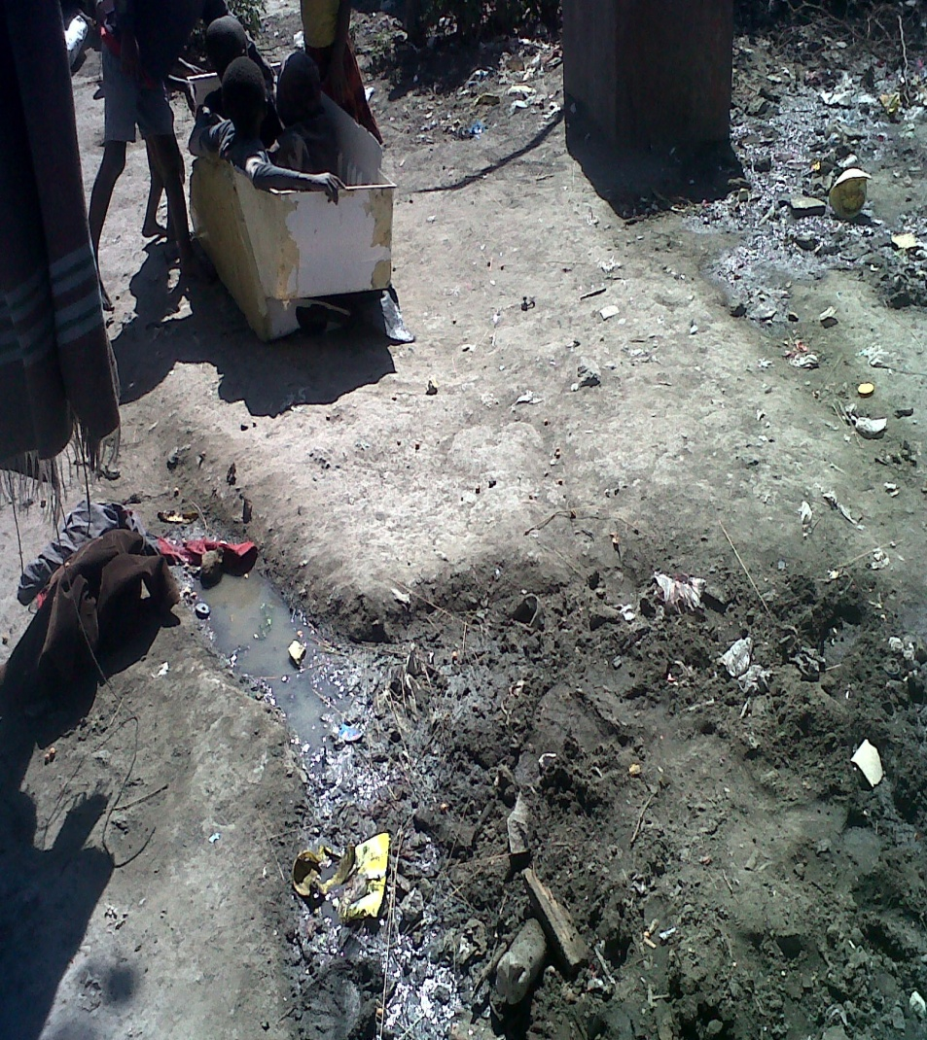
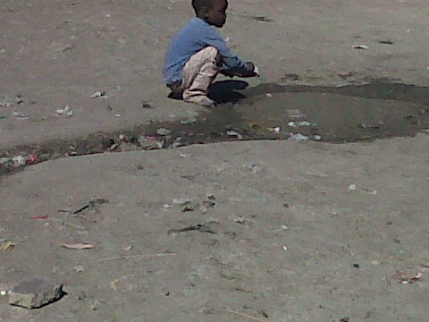

Slide 21
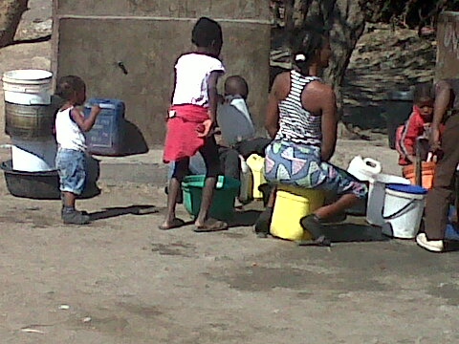

Slide 22
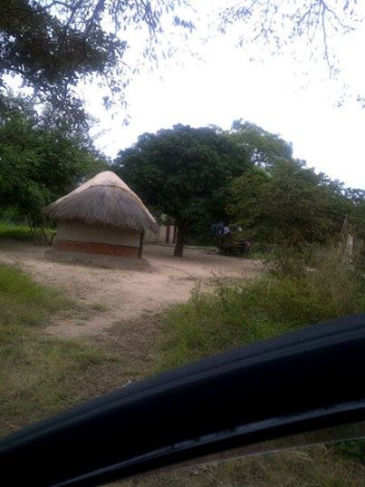
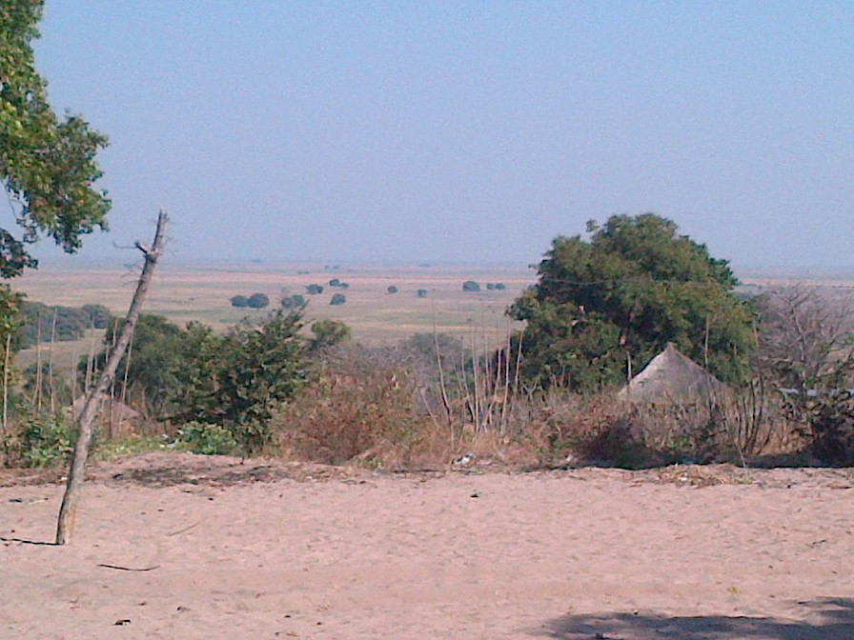

Slide 23
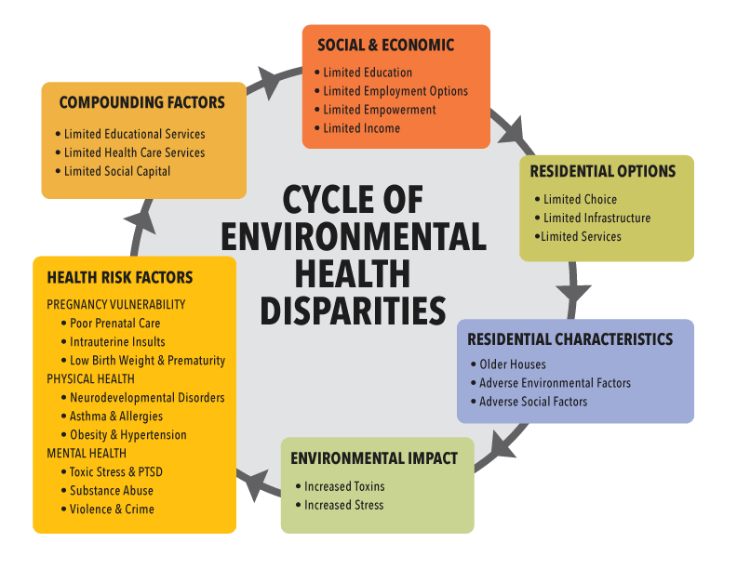

Slide 24
Conclusions
The use of DDT for malaria control in Zambia poses an ethical dilemma because in most cases it is only used in low cost housing structures inhabited by people who are also socio-economically disadvantaged.
The children from these homes are already exposed to other health risks and usually born from parents with very poor educational levels.
The effect of SES on the Neurodevelopmental Outcomes requires further exploration.
Inclusion of Chongwe in the analysis.

Slide 25
THANK YOU FOR YOUR ATTENTION
Questions are welcome

