Slide 1
Break the Cycle:
Lead Education with the Boys and Girls Club of Metro Atlanta
Students: Catherine Evans, Patrick Fueta, Amrita Mahtani, Sam Peters
Advisor: Dr. W. Mike Caudle
Emory University
Rollins School of Public Health - Environmental Health Department
April 25, 2017

Slide 2
Lead Poisoning in the US and Georgia
4 million children at risk for lead poisoning at home
Half million of children with blood lead levels >5μg/dL
2500 children in GA with elevate blood lead levels
Sources: https://www.cdc.gov/nceh/lead/
https://dph.georgia.gov/lead-data-and-reports

Slide 3
Sources of Household Lead
Paint
Lead pipes
Toys
Dust
Pottery
Soil/Gardens

Slide 4
Effects of Lead Poisoning
Learning
Hearing
Behavioral
Immune System

Slide 5
Breaking the Cycle
Environmental Risk Factors
Environmental Characteristics
Reduce Toxicant Exposure
Cycle of Environmental Health Disparities
Personal Characteristics
Health Risk Factors
Reduce Neurotoxicity, Learning Disabilities, & Behavioral Disorders
Compound Risk Factors
Health Characteristics

Slide 6
Methods
Define project objectives
Network with EPA
Cold call Boys and Girls Clubs
Proposal
Review past curriculum/EPA materials
Design curriculum, pamphlet, knowledge survey, lead screening kits
Pre-test & Pilot
Development
Class with the Decatur Boys and Girls Club
Parent’s Night
Implementation

Slide 7
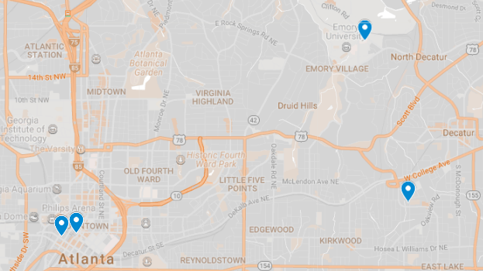
Community
Partners
Emory University School of Public Health
Children’s Hospital of Atlanta
(Pediatric Environmental Health Specialty Unit)
EPA Region 4
Boys and Girls Club of Metro Atlanta (Samuel L. Jones - Decatur)
Georgia Department of Public Health

Slide 8
Curriculum Outline
1. Introduction and Vocabulary
2. What is Lead?
3. Lead Exposures and Hazards
4. Interactive Game
5. Take-Home Talk
6. Parent’s Night
Monitoring and Evaluation
Knowledge survey – Pre and Post Lead Curriculum
Distribution of lead screening tests
Notes:
SJWP

Slide 9
1. Intro and Vocab

Slide 10
2. What is Lead?
Description
Current events
Differential effects
Behavior impacts exposure
Notes:
Differential effects for different populations

Slide 11
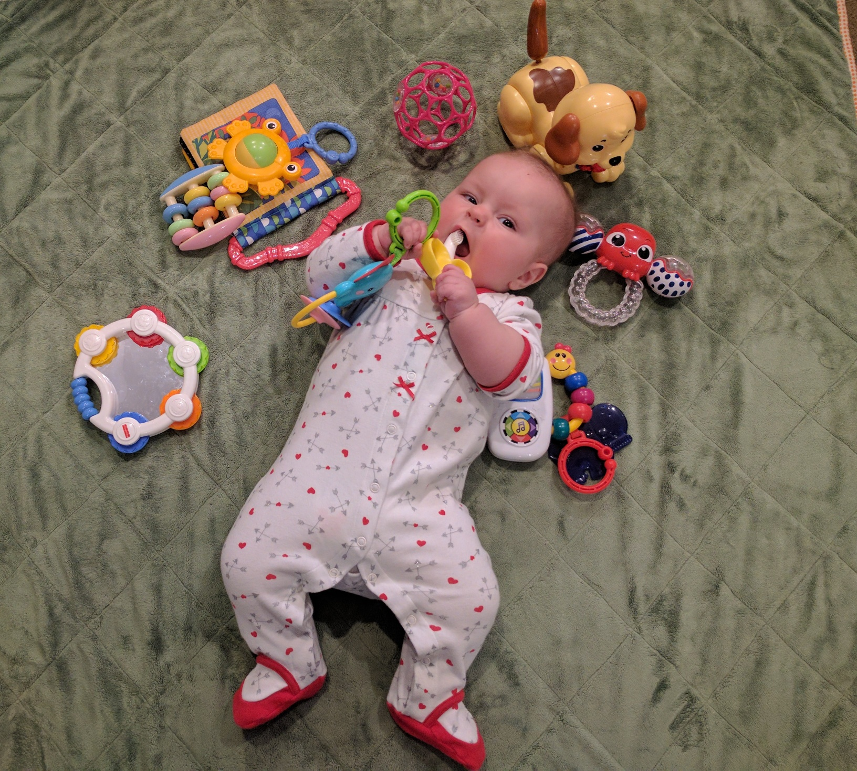
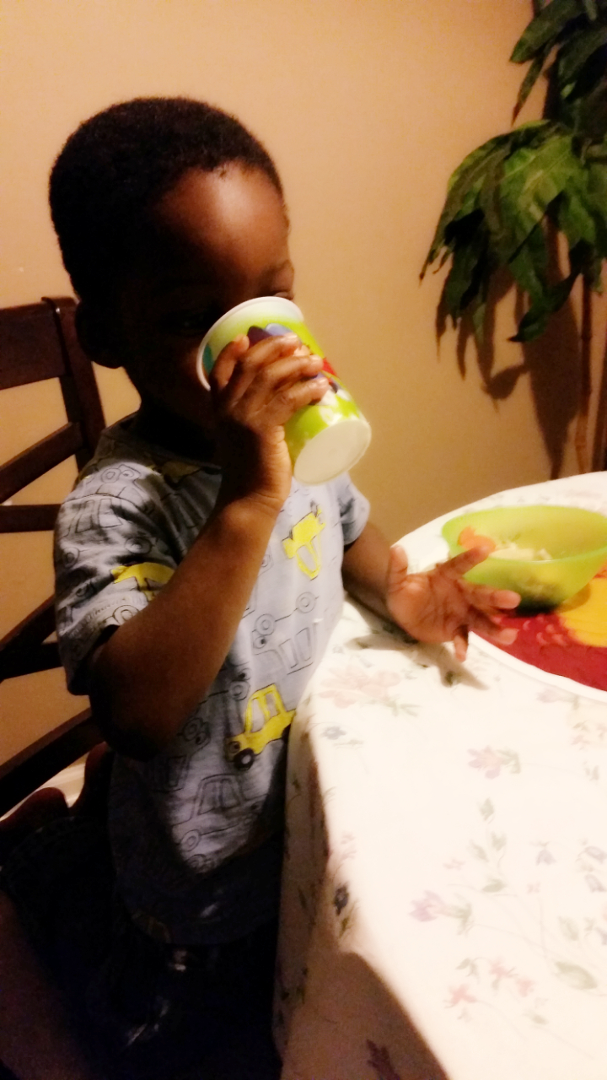
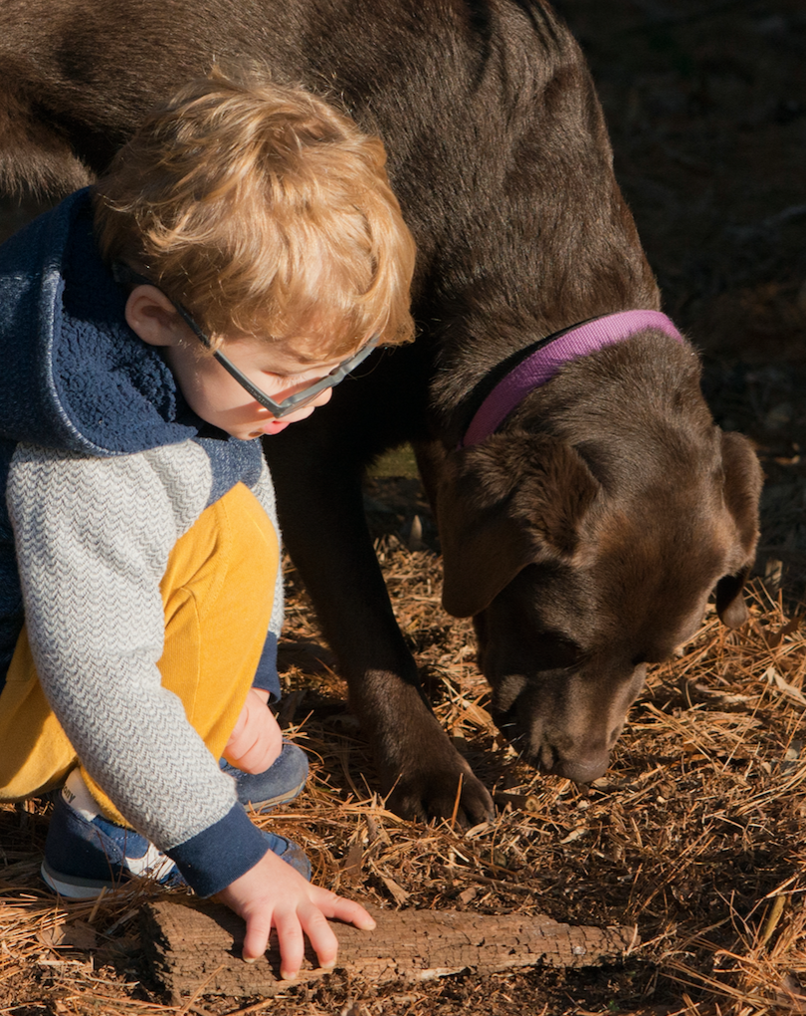
3. Lead Exposures and Hazards

Slide 12
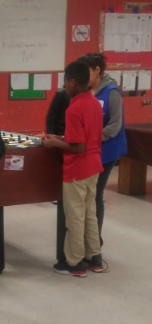
4. Interactive Game
Play Detective
Sources, Foods, Screening Locations
Midpoint Monitoring
Lead Definition, Exposure Routes, Mitigation Methods
Notes:
PF

Slide 13
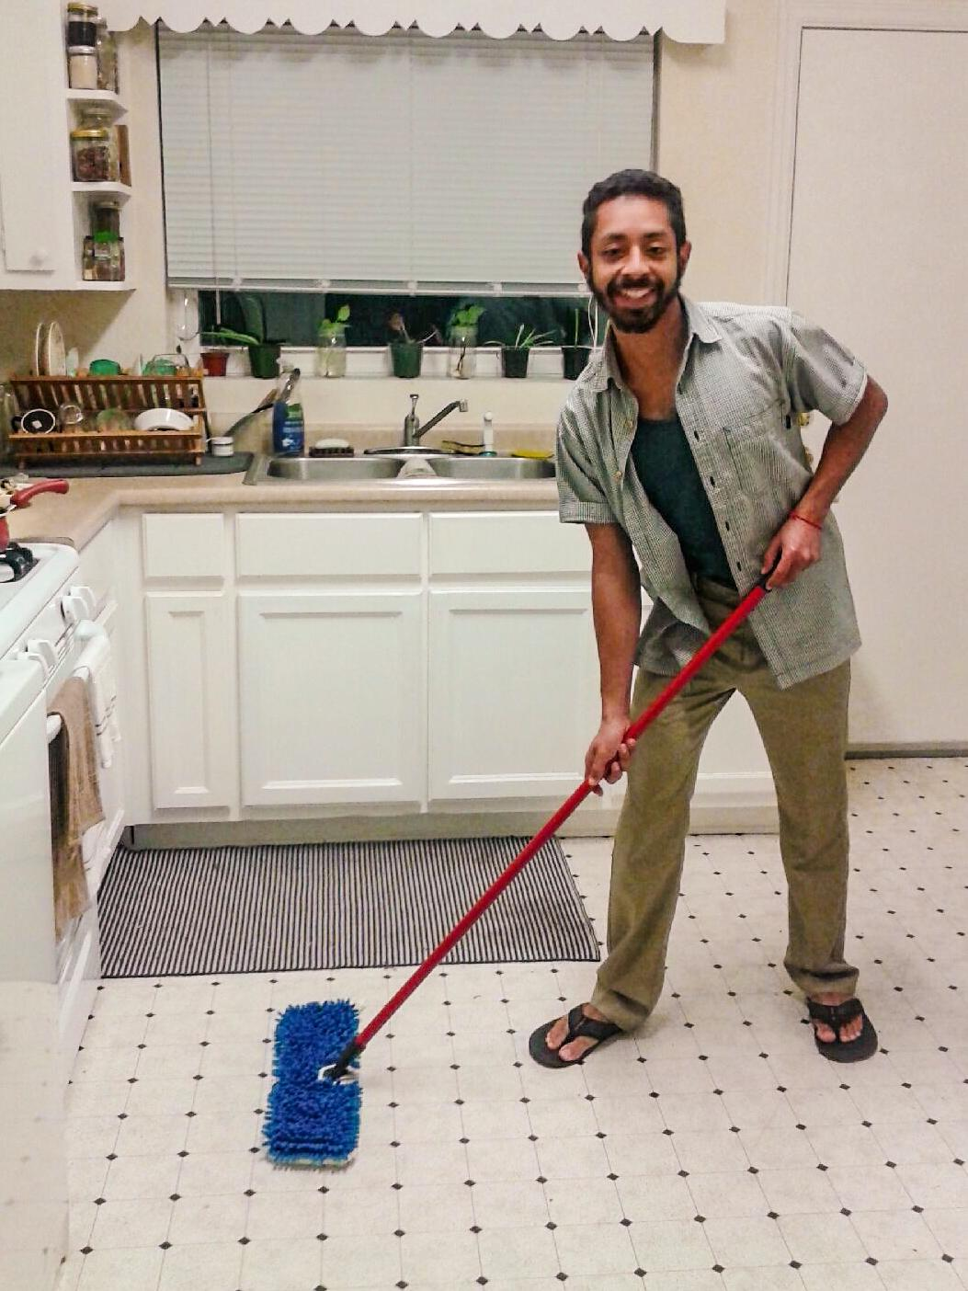
5. Take Home Talk

Slide 14
6. Parent’s Night
1 week following class
Intent
Round table discussion with lead experts
Actual
Conversations with a few, brief talks with most
Distribution of lead screening tests
Notes:
(EPA, CDC, GDPH)

Slide 15
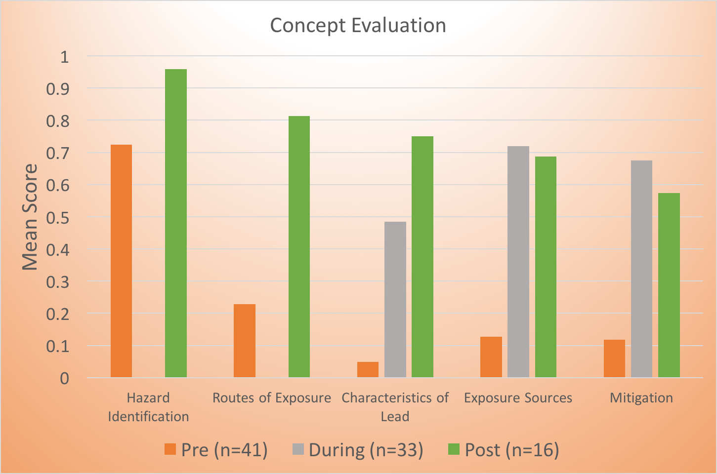
Monitoring and Evaluation
Knowledge Survey – Pre and Post Lead Curriculum
Notes:
CGE

Slide 16
Limitations
Pre-Test Survey
Pre/Post Compatibility
Sample Size
Time
Room Setup
Lead Screening Kits
Notes:
The pre-survey did not have boxes for the children to note down answers. There were many questions about this during the class.
Pre-test was given on paper with all the kids together in one room - very noisy, distracted by the pencils
Post survey was modified slightly for clarity and was done on a google form
Lead Screening Kit - Parent’s Night – only spoke to a few parents and incentives for kids (budget for it)

Slide 17
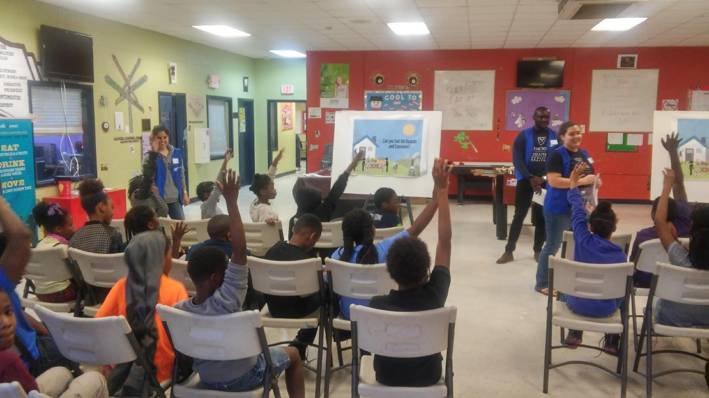
Discussion and Lessons Learned
Project motivation!
Less is more
Smaller groups of students
Short curriculum
Parental engagement
Notes:
Great to have the EPA and Wayne excited about our project and give us goals
Parent Engagement – BGC told us to have incentives (food)

Slide 18
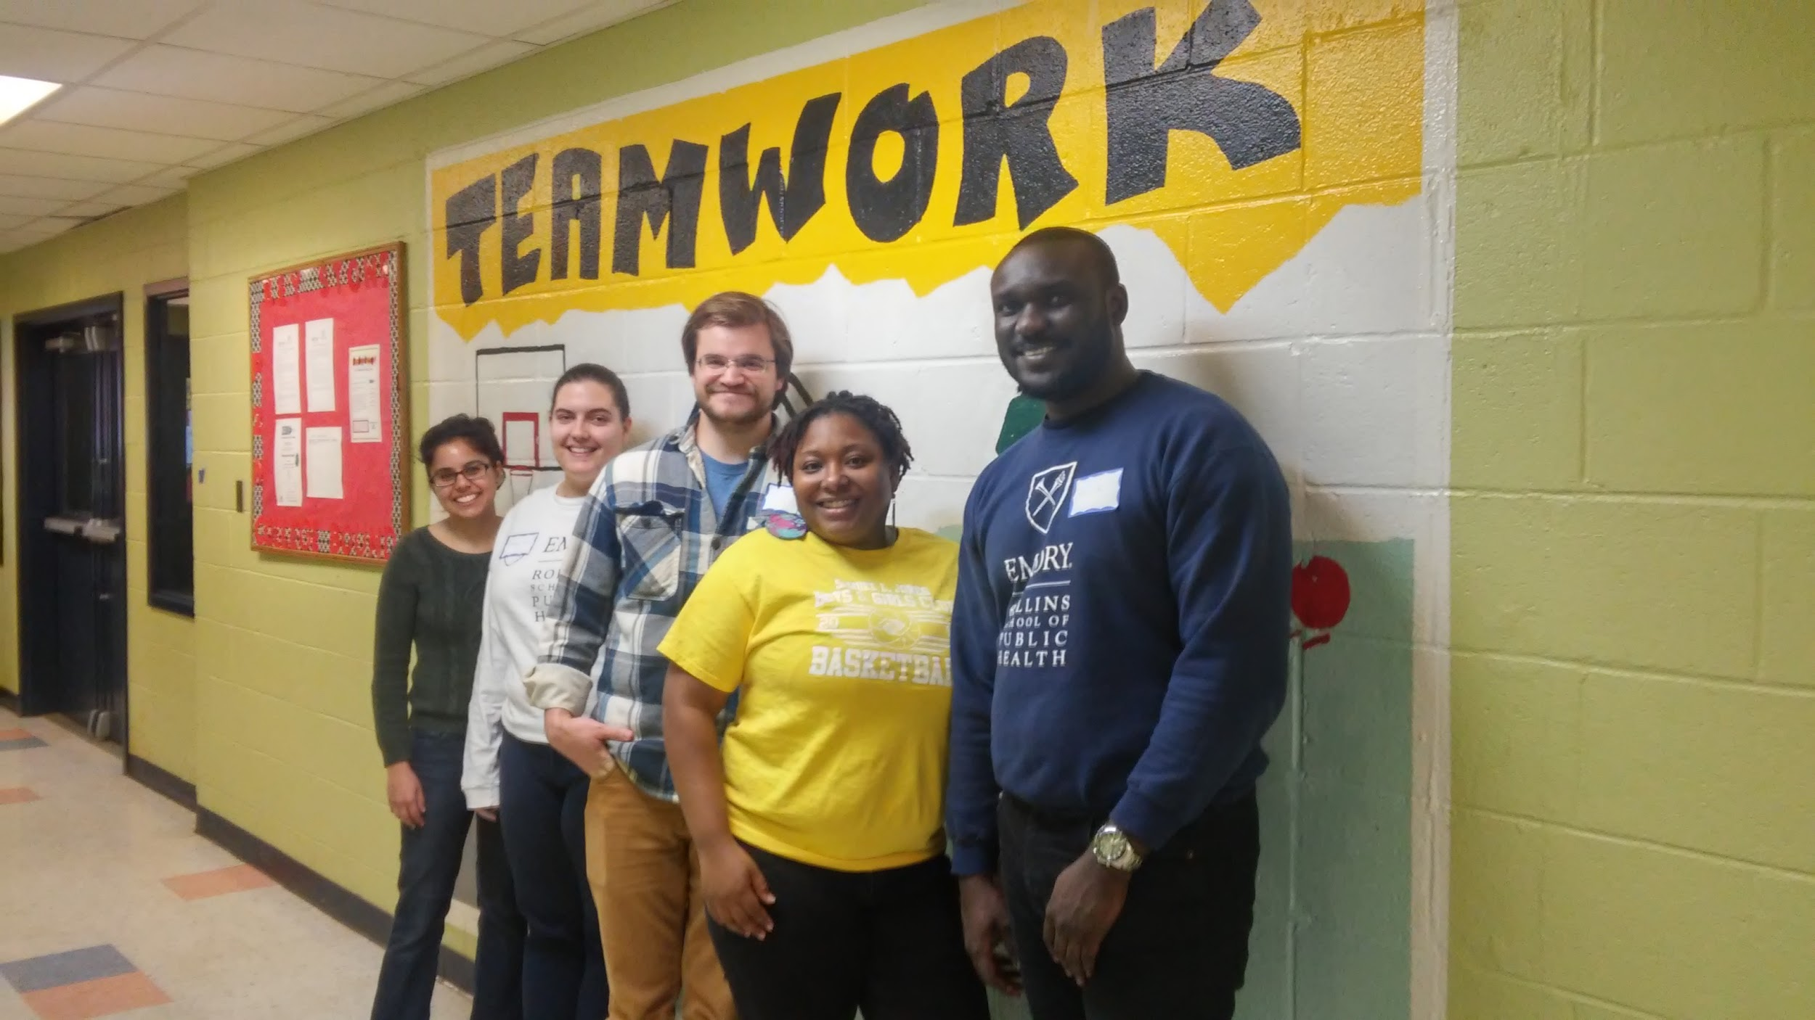
Next Steps
Edits based on pilot
EPA: Healthy Recipes
Dissemination Plan
EPA, GA DPH, ATSDR

Slide 19
Thank You!
EPA Region 4: Wayne Garfinkel, Samir Gala, Anthony Tony, Donnette Sturdivant, Amber Davis
Peers: Candis Hunter, Mary McGillicuddy, Adaobi N.C. Okocha, Leslie Salas
Photo Credit: Barrett Smith, Neal Evans, Tyanna Jackson, Amanda Kloer, Candis Hunter, Oghale Chifiero, Ufuoma Umukoro
Decatur Boys and Girls Club: Tyanna Jackson, John Strong
Break the Cycle Team

