Slide 1
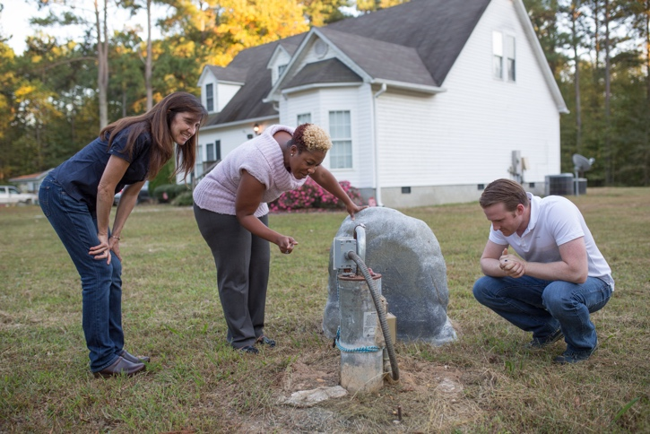
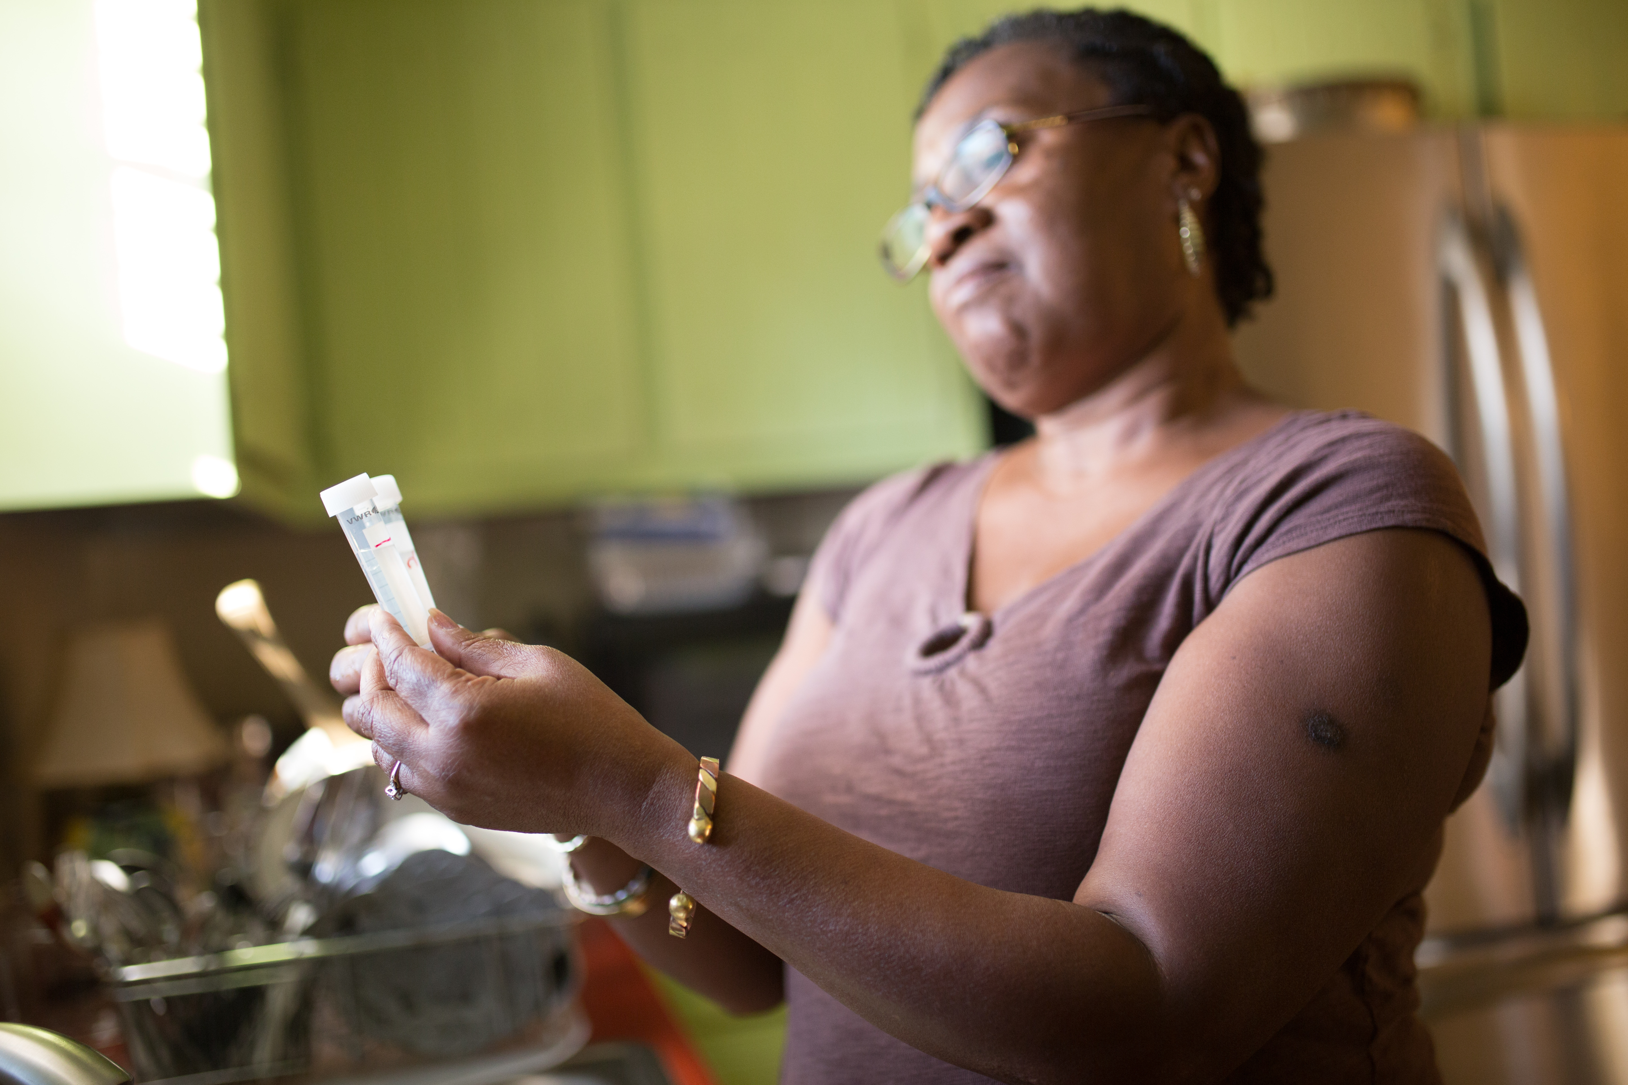
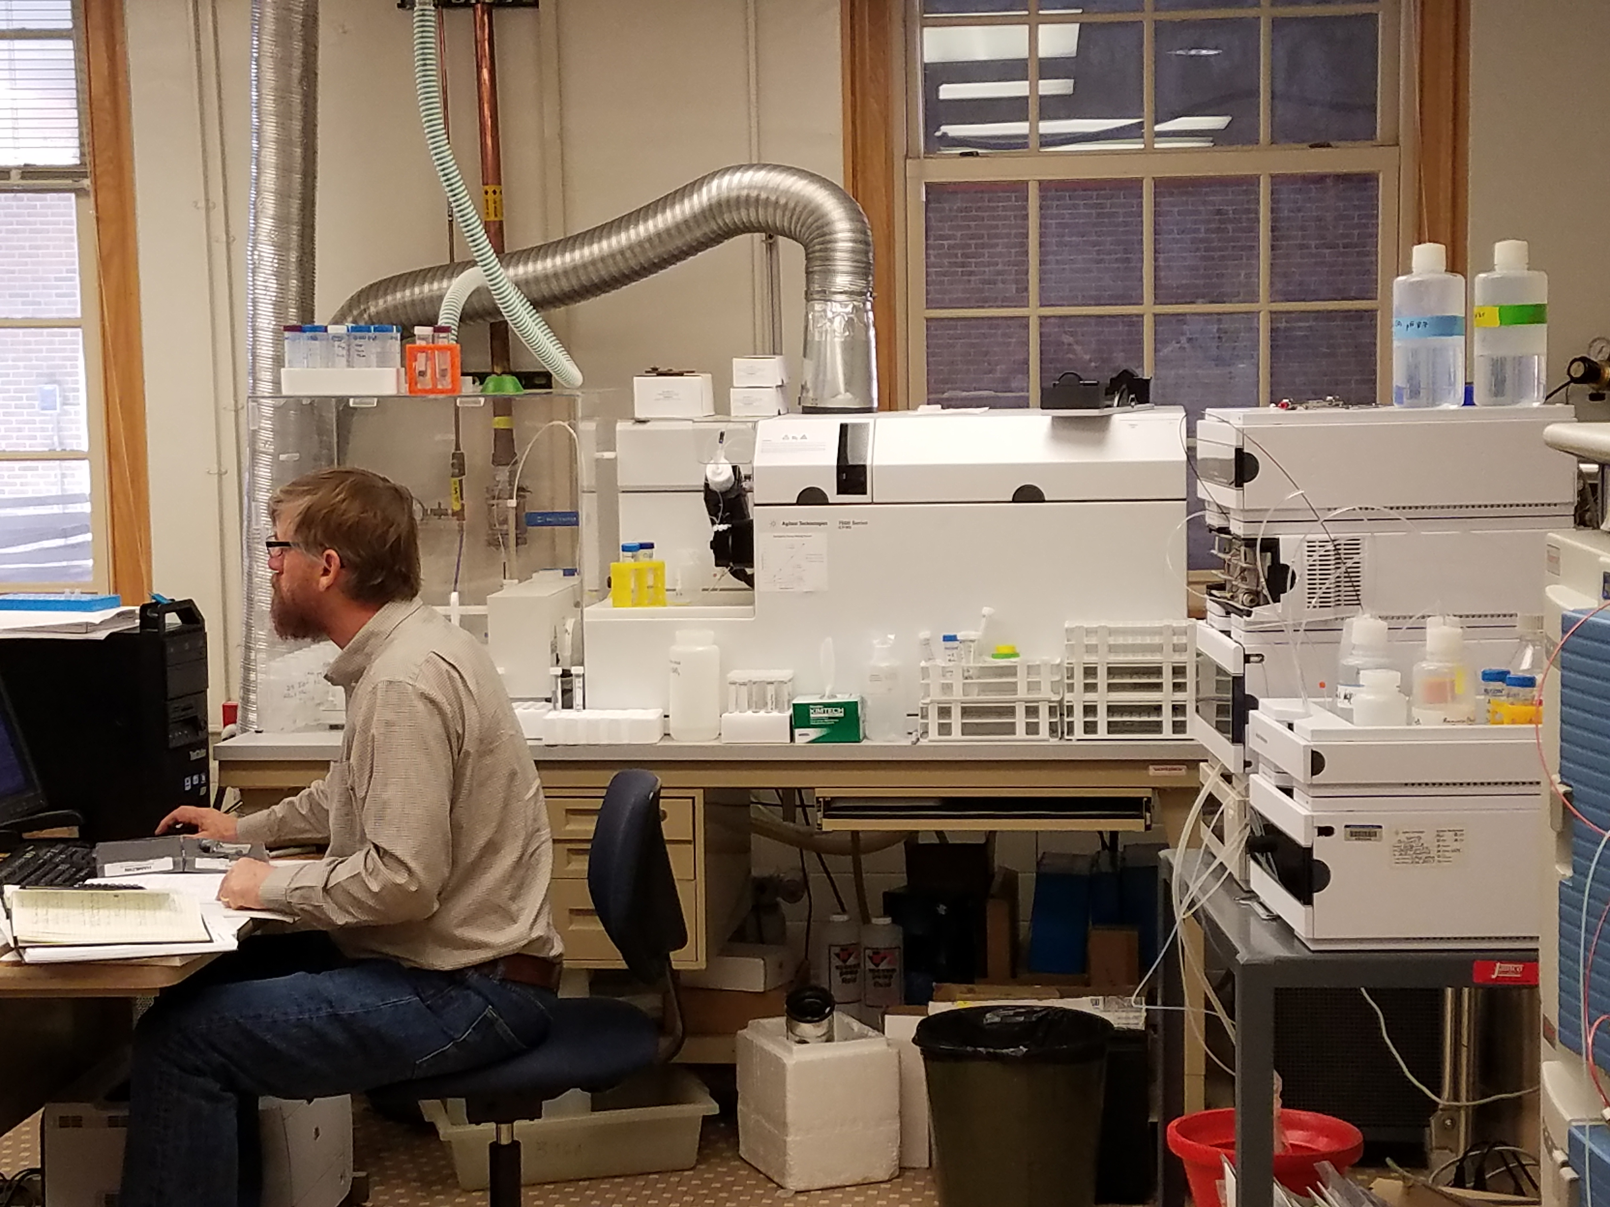
Racial Disparities in Access to Municipal Water Supplies in the American South: Impacts on Children’s Health
Frank Stillo III, MSPH | Jacqueline MacDonald Gibson, PhD
University of North Carolina at Chapel Hill
Gillings School of Global Public Health
April 24, 2017

Slide 2
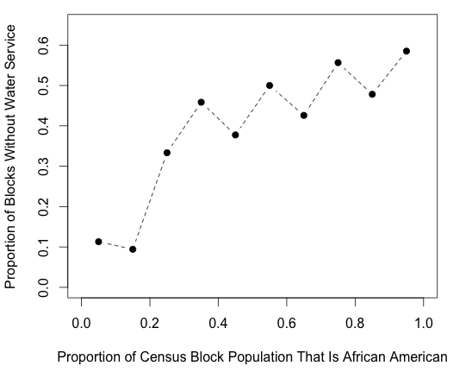
Prior Research Revealed Racial Disparities
in Access to Municipal Water in Wake County, NC
Every 10% increase in African American population proportion increases odds of being without water service by 3.8% (p<0.05).
Source: MacDonald Gibson J.; DeFelice N.; Sebastian D.; Leker H. Front. Public Heal. Serv. Syst. Res. 2014, 3 (3).

Slide 3
Marginalized Communities Are Surrounded
by Municipal Water Supplies
Some peri-urban African American communities are surrounded by municipal water supplies but lack connections to those supplies.

Slide 4
Water Mains Encircle This Excluded Community
“Underbounded” Wake County, NC, neighborhood
Water mains, shown in blue, surround the neighborhood
Connection labels illustrate locations where infrastructure extension can occur
Map courtesy of Heather Dew, MS; 2015.
Notes:
This map shows water pipes around the African American community encircled by Aberdeen as of about 2005. You can see that water pipes surround but do not serve the African American community. It appears that this community was excluded from municipal water service—it was underbounded.

Slide 5
Our Previous Study Revealed Poor Microbiological
Water Quality in Marginalized Communities
Poor private well water quality compared to municipal systems
E. coli were positive in 14% of households and 6% of all samples
Source: Stillo F, Gibson JM. Am J Public Health. 2017;107(10):180–5.

Slide 6
Our Previous Study Revealed Poor Microbiological
Water Quality in Marginalized Communities
Three households tested positive for both E. coli and enterococci in repeat samples, indicating high fecal contamination risk
Source: Stillo F, Gibson JM. Am J Public Health. 2017;107(10):180–5.

Slide 7
We Estimated That Microbial Contamination Increases Gastrointestinal Illness Risk by 22%
Source: Stillo F, Gibson JM. Am J Public Heal. 2017;107(10):180–5.
Notes:
25 ER visits avoided

Slide 8
Current Research Focuses on Lead Exposure
via Drinking Water
Objective 1: Examine the prevalence and concentration of lead contamination in 29 homes in African American neighborhoods of Wake County, NC, excluded from municipal water services.
Objective 2: Estimate the effects of exposure to lead in drinking water in these communities on blood lead levels in children under age 6.
Objective 3: Estimate IQ loss associated with lead in drinking water in these communities in children under age 6.

Slide 9
Knowledge of Lead Exposure Risks and Health Effects
Can Help Break the Cycle
Personal Characteristics
Environmental Risk Factors
Health Characteristics
Health Risk Factors
Compound Risk Factors
Discrimination due to minority status
Limited health literacy (water well monitoring, maintenance)
Inadequate infrastructure
Exposure to lead in water
Neurotoxicity
Learning disorders
Behavior problems
Notes:
Exclusion from municipal water infrastructure on the basis of race
Resulting increase in risk of exposure to lead in drinking water
Subsequent risk of IQ loss, learning deficits, juvenile delinquency
Raising awareness can help break the cycle

Slide 10
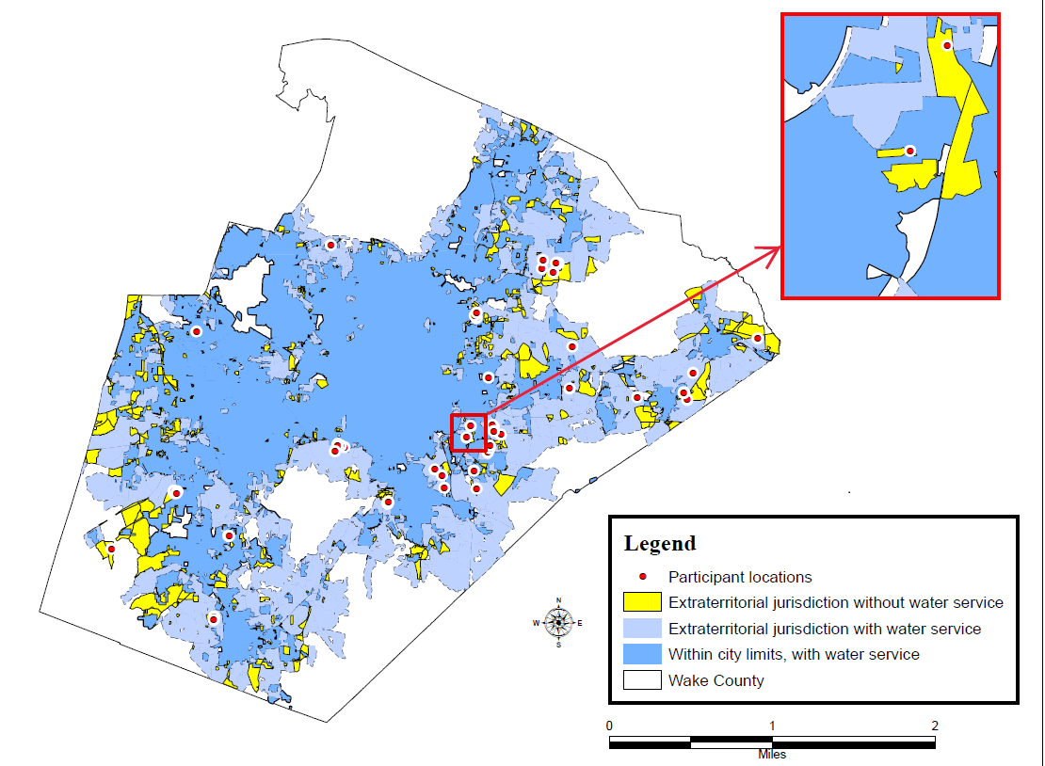
29 Households Recruited from Underserved Communities
Of the original 57 homes studied for microbial contamination, 29 were recruited for water lead testing.

Slide 11
Sampling Methods for Lead in Private Wells
Two consecutive water samples collected from the kitchen tap after overnight stagnation period
Pre-acidified containers
Tap aerator left in place
Acidified with 2% nitric acid; analysis by ICP-MS using standard method 3125B(3)

Slide 12
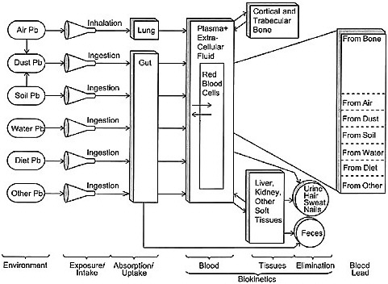
Health Outcome Estimation Method Used
Established EPA Model
Integrated Exposure Uptake Biokinetic Model (U.S. EPA 1994) used to estimate child blood lead level
Childhood IQ decrement estimated from longitudinal cohort study of 1,333 children (Lanphear et al. 2005)
Notes:
Comparative studies have show IEUBK to be superior to O’Flarety, Leggit, Bert

Slide 13
Results: Some Private Wells Have High Lead Concentrations
EPA action level
(15ppb)
Notes:
Although 7 houses had mean concentrations exceeding 15ppb, 8 houses had at least one sample exceed this level.

Slide 14
Pipe and Plumbing Fixture Corrosion
Are the Likely Lead Sources
3 of the 4 major elements in brass correlate with lead contamination
Notes:
3 of the 4 major elements in brass correlate with lead contamination
Infrastructure extension would add corrosion inhibitors to water; The upperright is the correlation – size indicates pvalue. Lower left is scatterplot of elements vs each other in the panel, and histograms of concentration in the diag.

Slide 15
Blood Lead Levels Could Exceed CDC Reference Levels
18 month old children are predicted to have the highest Blood Lead Levels

Slide 16
Children in Houses with the Highest Exposures Risk IQ Loss
Water lead levels alone potentially cause IQ decrement.
Notes:
In the chart, I show mean and 95% CIs for IQ loss attributable to water only for each household. The 95% CIs take into account uncertainty in the coefficient relating BLL to IQ loss (from the Lanphear paper), but not other sources of uncertainty.

Slide 17
Conclusions: How to Break the Cycle
Educate well owners about the importance of testing their well water for lead and other contaminants.
Improve access to water/ sewer infrastructure in peri-urban African American neighborhoods.
Provide support for well owners to install treatment systems when contaminants are detected.
Notes:
Racial disparities in access to municipal water service may increase the risk of exposure to lead in drinking water in some households. In turn, increased exposure to lead in drinking water could increase blood lead levels and decrease IQ.

Slide 18
Public Health Community Can Play a Key Role
“I think the health director saying this is a community health hazard . . . that means you’ve got to take care of it. . . . That ended the argument.”
New Hanover County official
Source: Naman, Julia Marie, and Jacqueline MacDonald Gibson. AJPH. July 2015: e1–e7.

