Slide 1
Evaluating In Home Intervention Strategies to Mitigate Disparate Respiratory Illness Rates in Disadvantaged Urban Pediatric Populations
Justin Babino & Emily McClendon
Georgia State University College of Law
Mentor, Assistant Professor John T. Marshall
Georgia State University College of Law

Slide 2
IN THE UNITED STATES
Number of noninstitutionalized adults who currently have asthma: 18.9 million
Number of noninsitutionalized children who currently have asthma: 7.1 million
http://www.cdc.gov/nchs/fastats/asthma.htm

Slide 3
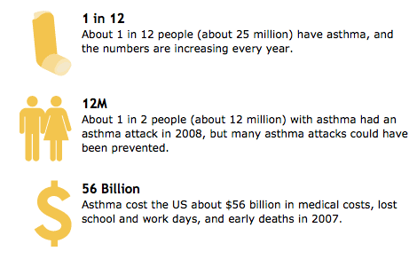
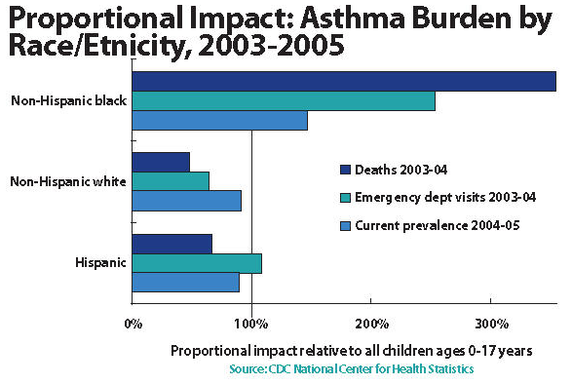
IMPACTS
http://www.cdc.gov/mmwr/preview/mmwrhtml/mm6017a4.htm?s_cid=mm6017a4_w
http://www.nlm.nih.gov/medlineplus/magazine/issues/fall07/images/asthma09_larger.jpg
http://www.nlm.nih.gov/medlineplus/magazine/issues/fall07/images/asthma09_larger.jpg

Slide 4
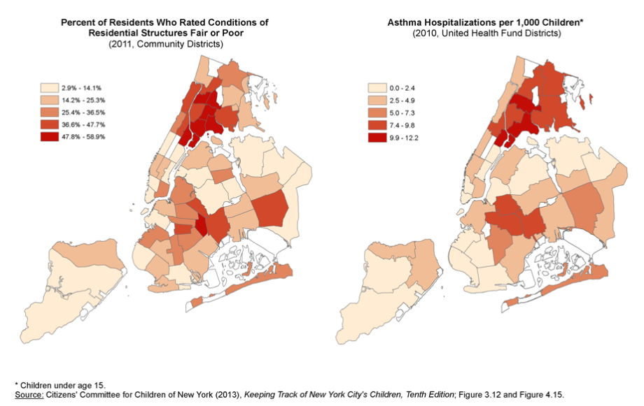
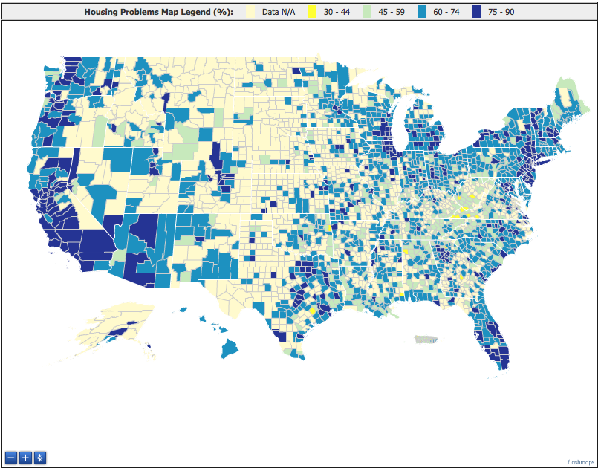
ASTHMA AND HOUSING STOCK
Correlation between poor quality housing stock and childhood asthma is very high
County Level Summary of Housing Problems in Low Income Households
http://www.huduser.org/tmaps/LI-household/chas.html

Slide 5
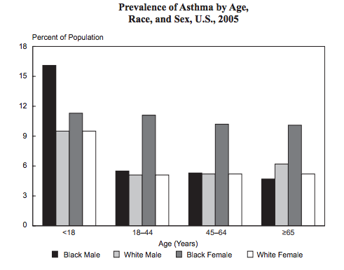
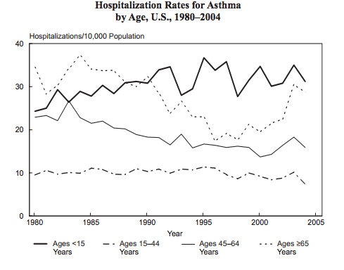
DISPARITIES
http://www.nhlbi.nih.gov/resources/docs/07-chtbk.pdf

Slide 6
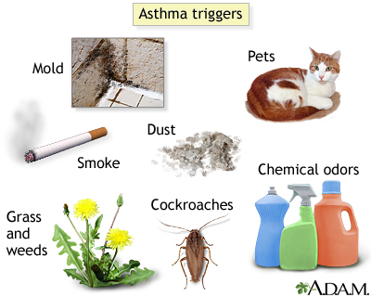
FACTORS – LOW QUALITY HOUSING
http://www.nlm.nih.gov/medlineplus/ency/patientimages/000280.htm

Slide 7
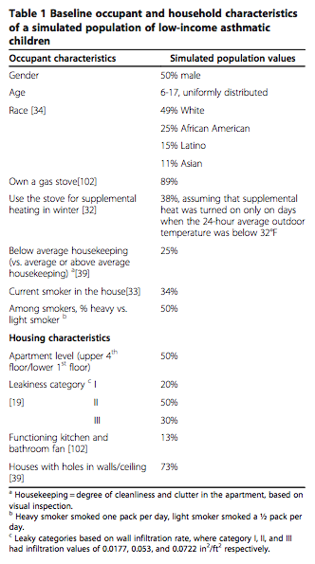
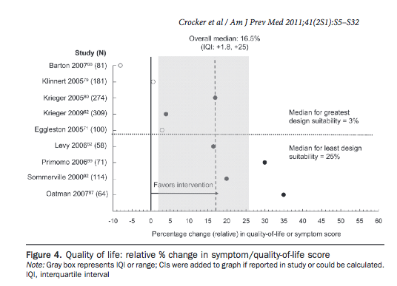
NATIONAL DATA
http://link.springer.com/static-content/lookinside/990/art%253A10.1186%252F1476-069X-11-66/000.png

Slide 8
HOW GEORGIA STACKS UP NATIONALLY
Georgia’s children have a higher asthma rate compared with other states.
Prevalence of asthma among African-Americans is much higher than for whites.
ER visits and hospitalizations for asthma occur at four times the rate for black children than whites.
Notes:
“Asthma numbers grim – particularly for kids” by Andy Miller, 5/23/12. According to 2008 statistics, Georgia’s children have a higher asthma rate, with a current prevalence of 12.1 percent, compared with other states’ rate of 9 percent.
Nationally, and in Georgia, the prevalence of asthma among African-Americans is much higher than for whites.
ER visits and hospitalizations for asthma occur at four times the rate for black children than whites.
Fewer African-Americans — even those with health insurance — are reported to be receiving appropriate control medication for asthma than whites.
Atlanta has been named the “Asthma Capital of the Nation” by Respiratory/Allergy Association.

Slide 9
GEORGIA DATA
Rate of Asthma Hospitalization among Children 0-17 years, by Health District, 2010
Rate of Asthma ER visit among children 0-17 years, by Health District, 2010
Notes:
2013 Georgia Data Summary – Child Asthma: The Georgia Department of Public Health. (Left) Five Health Districts with the highest asthma hospitalization rate in 2010 were Dublin, Valdosta, DeKalb, Albany and Waycross with rates of 520, 220, 190, 178, and 176 per 100,000 respectively. (Right) Five Health Districts with highest ER visit rate were DeKalb, Augusta, Fulton, Jonesboro and Albany with rates ranging from 1200 per 100,000 in Albany to 1816 per 100,000 in DeKalb.
Asthma prevalence was higher among non-Hispanic black children (10.3%) than among non-Hispanic white children (8.4%).
Overall asthma hospitalization rate was more than two times higher for black children (191 per 100,000) than white children (78 per 100,000) and this was consistent across each age group.
ER visit rate was higher among black children. Overall rate among black children approximately four times higher (1985 per 100,000) than among white children (483 per 100,000).

Slide 10
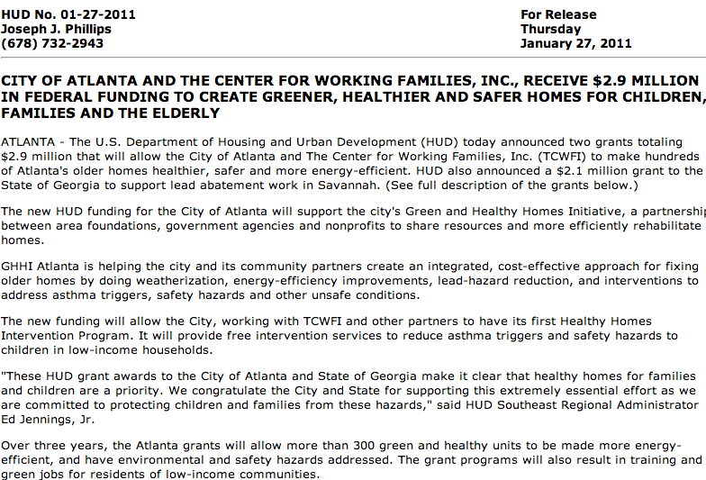
HUD FUNDING - ATLANTA
http://archives.hud.gov/local/ga/news/pr2011-01-27.cfm

Slide 11
DATA RESULTS
As we have recently completed IRB approval, this slide will be completed after further data analysis of GHHI interventions

Slide 12
ENVIRONMENTAL JUSTICE: WHAT IS IT?
Rooted in :
Fair treatment
Meaningful involvement
Authority: Executive Order 12898, Feb. 11, 2004
Regulation:
24 CFR 50.4(l) and 24 CFR 58.5(j)
Notes:
Definition: Addresses disproportionately high and adverse human health or environmental effects on minority and low-income populations.
According to the 2011 National Center for Health Statistics by the CDC… Children have a higher asthma rate than adults in the United States. There are significant racial health disparities with the disease.
http://www.cdc.gov/asthma/asthmadata.htm

Slide 13
TREATING SUBSTANDARD HOUSING
Develop ordinances to regulate indoor air quality.
Fund and promote training programs for local government code enforcement officers.
Fund and promote review of existing ordinances that can be amended to address health and safety hazards that frequently give rise to asthma.
Notes:
Outcome of the collaborative interagency Asthma Disparities Working Group, co-chaired by HHS, EPA and HUD. The goal of the Action Plan is to reduce the burden caused by asthma, especially among children — in particular, minority children and children with family incomes below the poverty level. The plan will promote synergy and alignment across numerous federal programs. It emphasizes priority actions that demonstrate a high positive impact on addressing preventable factors that lead to asthma disparities.

Slide 14
MEDICAL LEGAL PARTNERSHIPS
Promote And Support Formal Medical Legal Networks Committed To Addressing Social And Environmental Determinants Of Health
Notes:
Health disparities in childhood are widespread and are often exacerbated by poor-quality housing. MLPs have allowed for innovative approaches that link families with environmental risks to legal advocates. There is currently a bill in the Georgia House of Representatives about MLPs, written by the health legislation class at GSU Law lead by Sylvia Caley. Furthermore, housing code ordinances should protect people with asthma against indoor air problems. However, Georgia doesn’t have any statutes for regulating and/or monitoring indoor air quality.
rights.

Slide 15
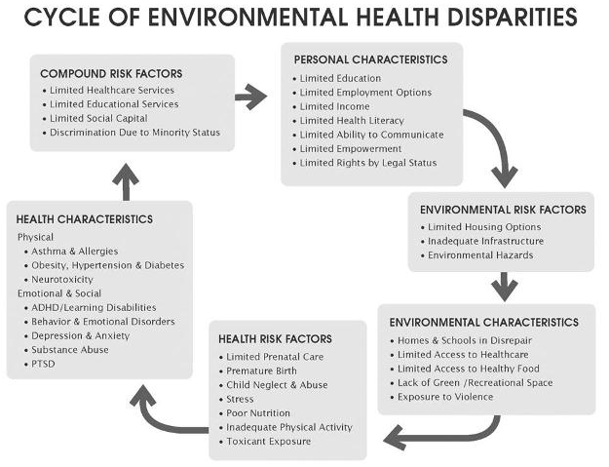
BREAKING THE CYCLE

Slide 16
WHERE DO WE GO FROM HERE
1. Reduce barriers to asthma management.
2. Enhance capacity to deliver comprehensive asthma care.
3. Improve capacity to identify asthma disparities.
4. Accelerate efforts that may prevent the onset of asthma.
Notes:
http://www.epa.gov/childrenstaskforce/index.html
May 2012, President's Task Force on Environmental Health Risks and Safety Risks to Children.
Coordinated Federal Action Plan to Reduce Racial and Ethnic Asthma Disparities

