Slide 1
Next Step Up: A Mentoring and Tutoring Intervention
Elise Marie Tolbert
Pamela J. Maxson, Ph.D.

Slide 2
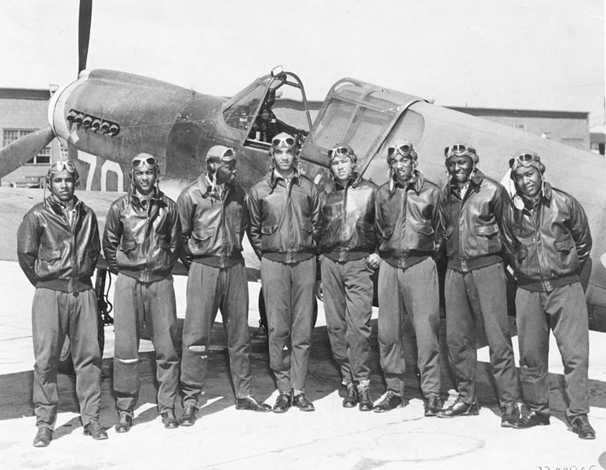
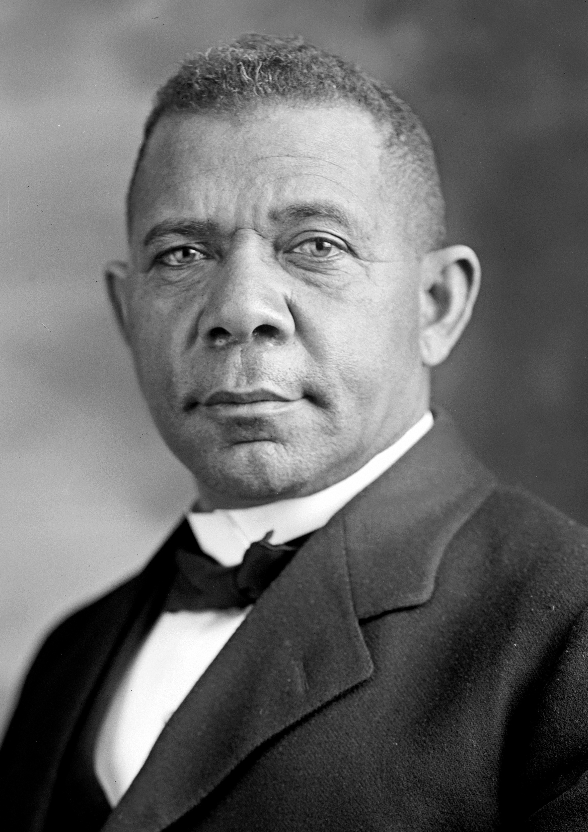
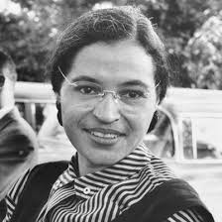
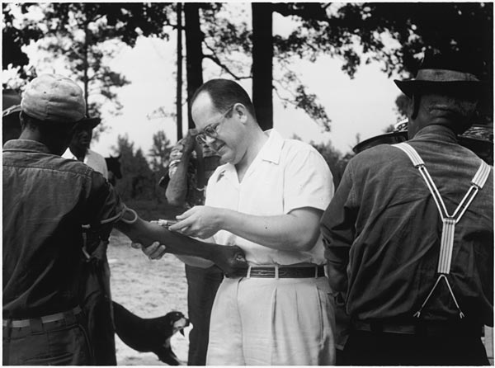
Tuskegee, Alabama: Historically
Booker T. Washington
Tuskegee Airmen
George Washington Carver
Rosa Parks
Tuskegee University
U.S Public Health Service Syphilis Study

Slide 3
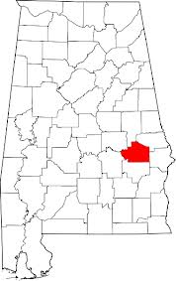
Tuskegee, AL: Present
Small rural community
Declining social capital
Rising teen violence
Declining job market
Increasing poverty
High school drop-outs
Teen pregnancies
Black population: 95.8%

Slide 4
Cycle of Disadvantage
Personal Characteristics
Limited Education
Limited Employment Options
Limited Income
Limited Health Literacy
Limited Empowerment
Compounding Risk Factors
Limited Healthcare
Limited Educational Services
Limited Social Capital
Discrimination Due to Minority Status
Environmental Risk Factors
Limited Housing Options
Inadequate Infrastructure
Environmental Hazards
Environmental Characteristics
Limited Access to Healthy Food
Limited Access to Healthcare
Lack of Green/Recreational Space
Exposure to Violence
Housing Damage and Property Disorder
Health Characteristics
Obesity, Hypertension, and Diabetes
ADHD/Learning Disabilities
Behavior and Emotional Disorders
Depression and Anxiety
Substance Abuse
Health Risk Factors
Poor Nutrition
Inadequate Physical Activity
Stress
Child Neglect and Abuse

Slide 5
The Cycle in Tuskegee
Disadvantaged Neighborhood
& Community:
Expectations
Lack of ownership
Accumulation of stress
Lack of support
School structural factors
Unknowingly perpetuate cycle
Parents:
Single parent households
Low attainment
Low involvement/support
Low expectations
Lack of knowledge/experience:
SAT, college apps, etc.
Students:
Reduced expectations
Low motivation
Reduced aspiration
Apathy
Low educational
attainment

Slide 6
My Observations
Booker T. Washington
High School Students
Tuskegee University Students
Lack of guidance
Devaluation of education
Not goal-oriented
However, many were smart and possessed potential to be successful
Negative view of the community
Fear of/lack of respect for community members
Lack of exposure to the community
However, they possessed potential to make a change
Bridging The Gap

Slide 7
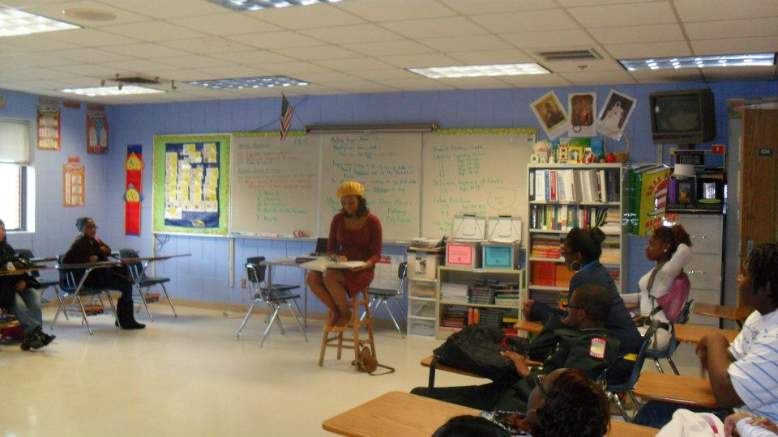
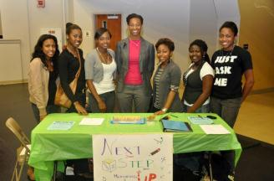
Next Step Up Mission
Enhance the overall student: academically, and socially by providing assistance and mentorship through healthy relationships so that students may realize academic achievement both in and out of high school.

Slide 8
Framework
In School Tutorials
Community Involvement
After School Sessions
Teacher Assistance
Individualized Assistance
Mentorship
Engagement
ACT/SAT Practice
Empowerment

Slide 9
Mutually Beneficial
Tuskegee students become involved in the community
Community feels more accepted and involved with the university
High school students acquire mentors

Slide 10
Breaking the Cycle
Provide Academic Support for Students
Homework Help
ACT/SAT Prep
Assistance In Class
Low Educational Achievement
Students Lack Guidance and Motivation
Provide Individual Mentoring
Discuss the importance of setting and reaching goals
Provide Opportunities for Exposure
Hosting College Fair
Host Prom Dress Drive
Informing Students of Post High School Options
Students Lack Resources and Exposure
Fragmentation Between Community, Schools and University
Community Outreach
Hosting and Participating in Community Events

Slide 11
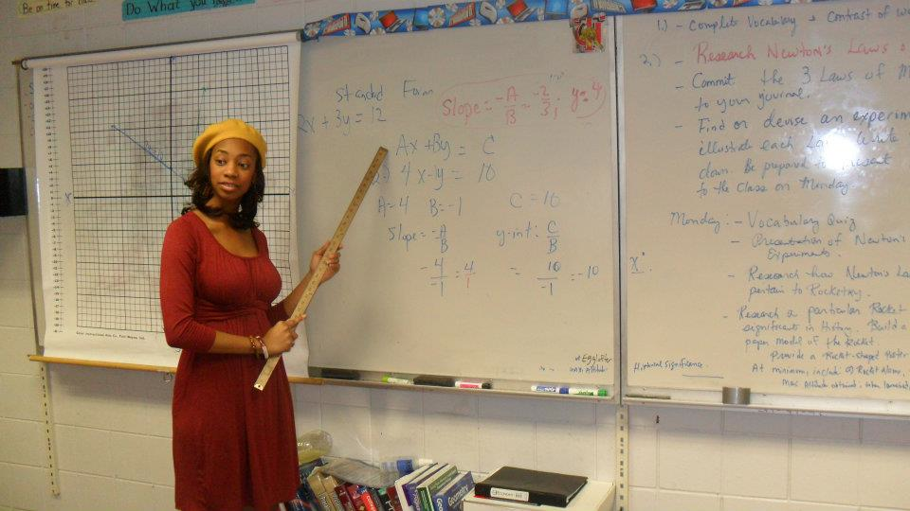
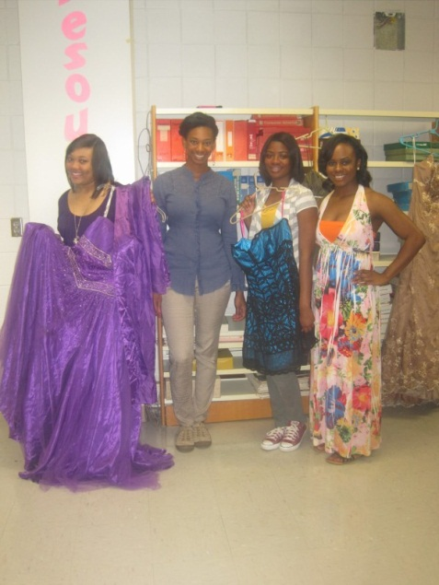
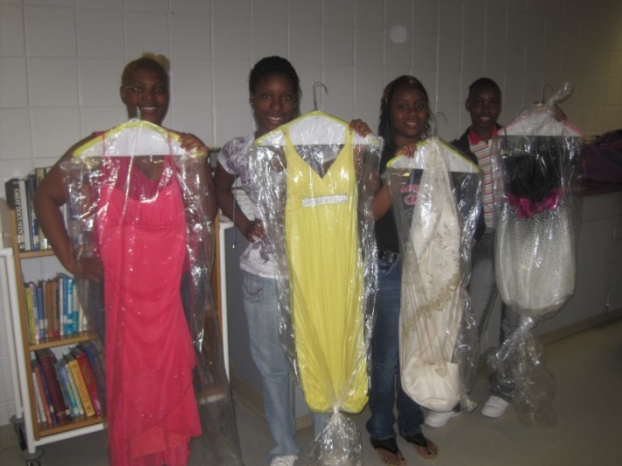
Breaking the Cycle in Action

Slide 12
Long-term Goals for NSU
Students will:
Increase their educational aspirations
Become more aware of career options
Understand how to pursue various options
Become more engaged in the community
Mentors will:
Develop leadership qualities
Enrich NSU participant performance and goals
Develop stronger ties to the community
Community will:
Increase parental engagement
Host more community centered events
Increase community pride
Notes:
Turn into graphic

Slide 13
What’s next?
Continue
Assess needs
Expand
Adapt
Develop mentors
Increase effectiveness
Reach more students
Refine program
Evaluate
Increase community involvement

