Slide 1
Breaking the Cycle with Medical-Legal Partnerships: A Comparison of Referral and Intake Practices with a Focus on Addressing Substandard Housing Conditions
Caroline Wick
Tulane University Law School
Tulane University School of Public Health and Tropical Medicine
Mentor: Colin Crawford, JD, MA
Tulane University Payson Center for International Development Tulane University Law School
Notes:
Interviewed 4 MLPs – asked about referral and intake practices. Is it possible to recommend best practices?

Slide 2
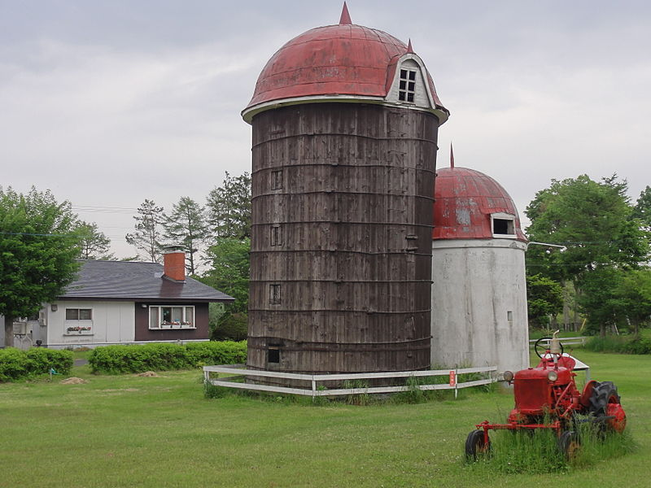
My Interest
“Medical Legal Partnerships”
Silos
Talking to professionals
Challenge
Notes:
Heard the term during my first year of law school at a presentation and had no idea what it meant. So I did some basic research and realized that it’s exactly what it sounds like – medical professionals and attorneys working together to address client’s legal needs.
The idea appealed to me because law seems to operate in a silo. Broadly speaking, attorneys don’t always make connections between their work and their clients and policy. In law school, especially, we focus on the law.
Conducting a project focused MLPs interested me because it would give me a chance to speak to professionals who are doing innovative, needed work.
This project was a challenge, though, because I didn’t know anything about Medical-Legal Partnerships going into it.

Slide 3
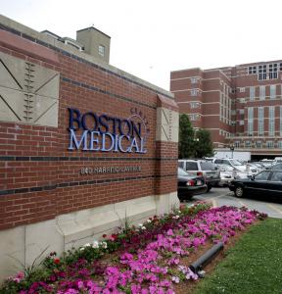
MLP Background
Dr. Zuckerman’s idea
Traditional medical model’s limitations
Patients’ multiple unmet legal needs
Notes:
BRAINCHILD. Barry Zuckerman of Boston Medical Center hadthe original idea for an MLP. It was in its most basic form at that time. He hired in an attorney to help address patients legal needs that were causing medical problems. “''I want an impact on the whole child, since you can't separate out a child's organ functions from the rest of his body and the context of his environment.’’
In other words, Dr. Zuckerman realized that the traditional medical model is limited in its capacity to serve patients if there is something in the home that is exacerbating their health condition. The MLP model asks medical caretakers to think about social determinants of health – housing conditions, working conditions, income, food, etc.
According to one study: one in six people live in poverty, and each of those individuals has a civil legal problem that negatively affects their health
So… the idea was, get these patients to an attorney
But how does this partnership work… As of 2012, MLPs existed in 38 states across the U.S. and are established in 100 hospitals and 166 community health centers
http://www.mlpboston.org/about-us/mission-and-history

Slide 4
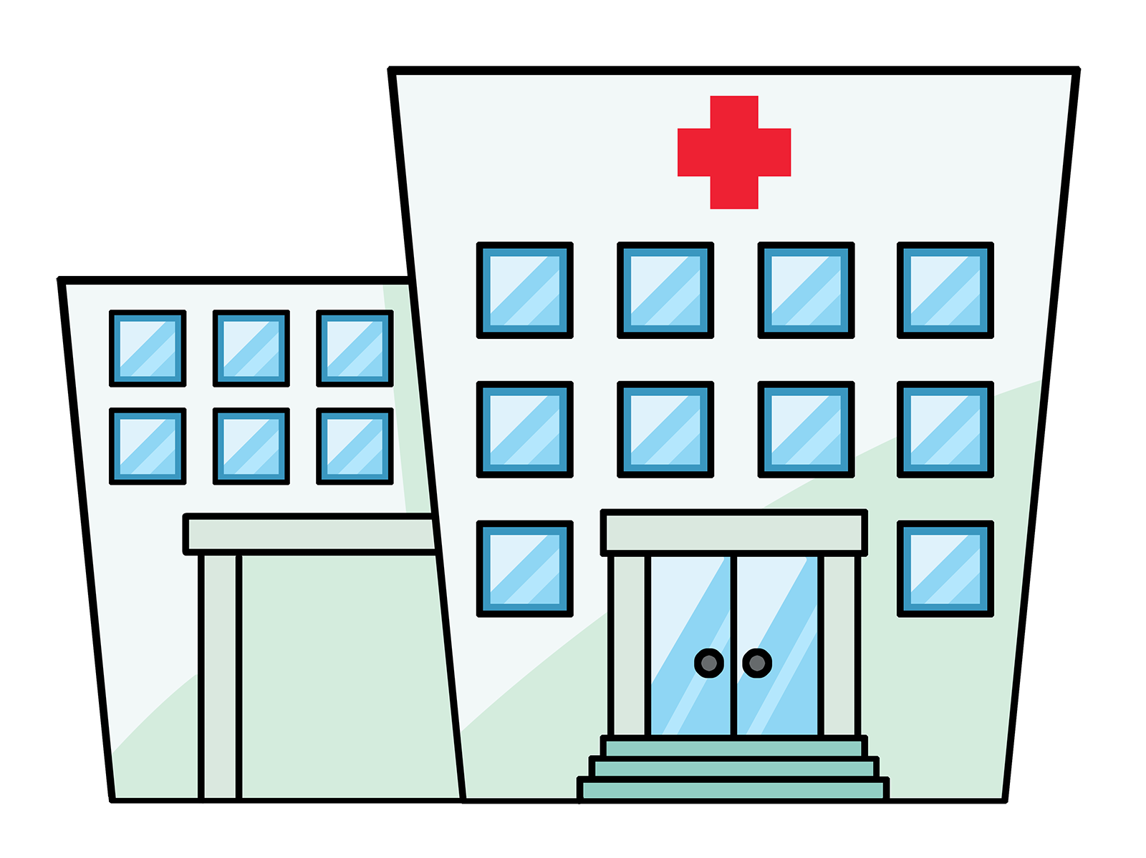
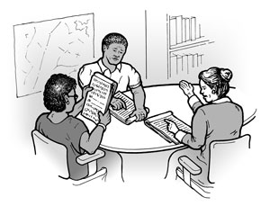
MLP Model
Medical
Legal
Referral
Intake
Notes:
Basic MLP model. Patients visit the medical provider. Caregivers ask questions to try to ascertain whether something at home is contributing to their illness. If the patient says that there is, the patient is referred to the legal side of the partnership. The patient might meet face-to-face with an attorney from the MLP or the attorney/investigator may make a phone call
This is a basic model. The medical side can be an emergency department, a primary care center in a hospital, a community health center, etc.
The attorneys can come from law schools and or nonprofits. Often, the attorneys from the nonprofits are part of a larger organization, but sometimes they form their own organization.
***Attorneys often onsite

Slide 5
MLP Activities
Legal Assistance
Analogous to Primary Care
Education
Advocacy
Notes:
MLPs undertake 3 activities.
1. Legal Assistance – analogous to primary care because it’s a form of preventive law and trying to engage in early detection and prevention. On the civil side, clients are not guaranteed a lawyer (as they are in criminal law), so clients often don’t seek help at the point of crisis. With the MLP attorneys try to address an issue before there’s a crisis – e.g. before the client receives an eviction notice.
2. Education – MLPs educate multiple actors. Medical staff educate attorneys; attorneys educate medical staff. Both sides work to educate judges and policymakers.
3. Advocacy – MLPs frequently use their knowledge to work to make systemic changes (e.g. advocating for changes to the housing code, etc.)
I wanted to focus my research on legal assistance – how does the patient become a client?

Slide 6
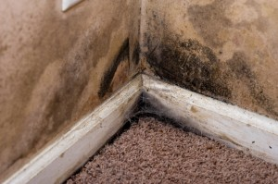
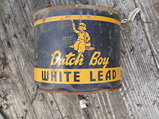
Focus on Housing
MLP practice area
Sub-standard housing and health connection
Current Crisis
Notes:
I wanted to ground my research in a specific environmental health issue. Sub-standard housing is an environmental health issue that every MLP tjhat I studied named as a practice area.
The MLPs that I studied housing was 20-50% of the practice
DC MLP also mentioned that they’re filling a niche b/c a lot of legal aid organizations will only take cases if they’re in eviction.
For more than a century, researchers have linked housing and health. Inadequately maintained buildings are known to contribute to a number of conditions including asthma, elevated lead levels, mold, bug and rodent bites. Patient may develop anxiety about the infestation. Ceiling collapses
As of 2007, “it was estimated that 9.0 million households were competing for 6.2 million affordable housing units.” No place for clients to go.

Slide 7
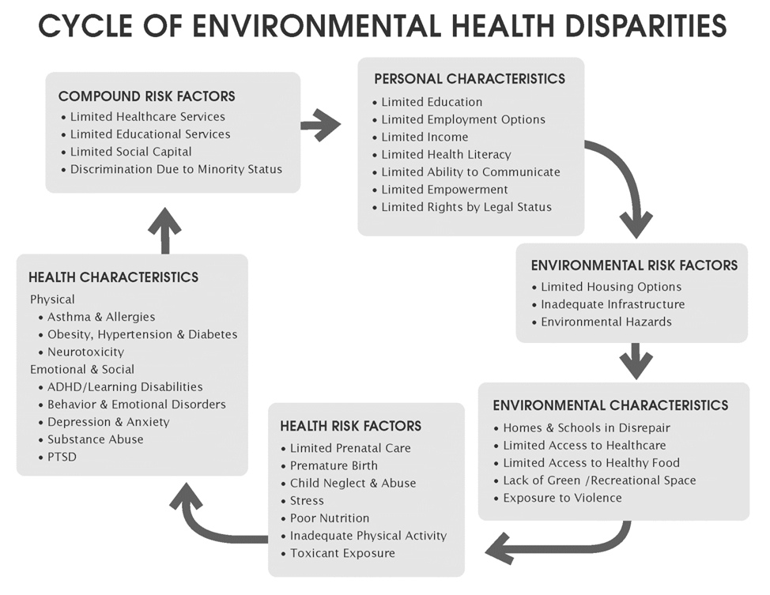

Slide 8
Basis for this Study
Referral and Intake Practices
Suggestion by MLP employee
Few studies in the literature
Area where MLPs are directing resources
Notes:
So like I said, curious about how MLPs work in practice… so I created my study to ask questions about intake and referral practices.

Slide 9
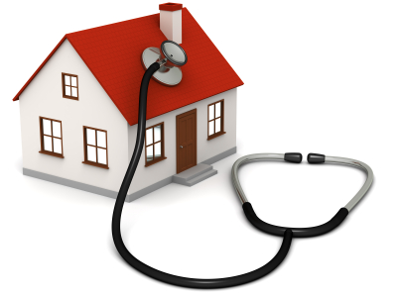
Methodology
Hypothesis
Non-probability sample
Semi-structured, in-depth interviews
Notes:
It is hypothesized that intake and referral practices for substandard housing conditions is a reasonable proxy for MLP legal cases most relevant to breaking the cycle of environmental and pediatric health disparities.
Also hypothesized that through the referral process MLPs are trying to capture as many referrals as possible and assist the client in the most efficient way possible.

Slide 10
MLPs Studied
Cincinnati Child-Health Partnership (Cincinnati, OH)
Healthy Together
(Washington, DC)
Health Law Partnership (Atlanta, GA)
**MLP | Boston (Boston, MA)
Notes:
Cincinnati: works with Cincinnati Children’s which runs 3 primary care centers that are directly affiliated with the hospital and serve as the referral base for Child HeLP. There is a team of 5 attorneys and paralegals who work for the MLP and they are a sub-group in the Legal Aid Society of Greater Cincinnati.
Washington, DC, Healthy Together: works with two medical partners (Children’s National Health System (main hospital and clinics around the city) and Mary’s Center).There’s a staff of 8 attorneys and 2 investigators that work for the MLP who are staff members of Children’s Law Center, a legal aid organization in Washington, DC.
Atlanta, HELP: collaboration between Atlanta Legal Aid Society, Georgia State University Law School, and Children’s Healthcare of Atlanta. Attorneys come from both Legal Aid Society and the Law School.
Boston, MLP Boston: partners with 7 healthcare partners and MLP Boston, which is its own nonprofit.

Slide 11
Research: Referral Practices
How best to screen?
Paper screen, live intake, or both?
How is the referral made?
EMR, phone call, email
Notes:
-Interested in the questions the medical side asks to determine whether there’s a legal need that’s exacerbating the child’s health problem. How are children screened?
-When are questions asked of the patient?
-support in the literature for a paper screen that patients fill out themselves (identifies more legal issues), efficiency, buy-in
-but some MLPs don’t give a paper screen and instead the medical provider asks questions
-Cincinnati: uses a paper screen, also social and environmental questions that get asked at every visit (included in the EMR)
-Atlanta: uses a paper screen, reviews that paper screen during the medical visit, working on trigger questions in the EMR
-DC: advocacy code card, general rule of thumb – if you think there’s an issue refer it
***All of the MLPs I talked to stressed: we’ve been working for a long time with the medical providers they know what questions to ask. On site 1-5 days.
How is the referral given?
-Cincinnati: in the EMR, print out
-Atlanta: call/email, consult form
-DC: Call, email, in the EMR

Slide 12
Recommendations: Referral Practices
Screening
Paper screen
Electronic Medical Record
When to Refer?
How?
EMR
Notes:
Trying to capture as many clients as possible…
Paper screen → support for it in the literature, efficiency
EMR ensures that questions get asked at every visit
Referral: flexibility vs. efficiency:
-DC’s general rule: refer it
-Boston: safe handoff. Boston has formalized a more collaborative approach (try to establish with the medical provider that there’s a legal issue that the attorney needs to be involved with before referrals is made)
Justifications: efficient, partnership – ongoing process of education

Slide 13
Research: Intake Practices
When and where?
Intake questionnaire
Extensive
Abbreviated
Abbreviated, issue-specific
Notes:
Atlanta MLP does a legal check-up which is based on the medical history/physical. They ask about all kinds of issues – child care, child abuse, education, employment. And then they can try to address all of these.
Cinicinnati MLP – does an initial intake and then they have a from that’s specific to the issue that the client has been referred for. So for housing conditions they ask, “Have you contacted your landlord?” Have you contacted the city?”
DC MLP – initial screening and then more detailed questions about the issue
Too many institutional variables to make a recommendation (pro bono, housed within a large organization?)

Slide 14
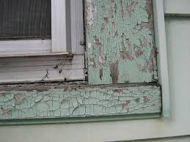
Recommendations: Intake Practices
Is the goal to identify all legal issues?
Comprehensive intake
Issue-specific intake
Form letters
Notes:
Trying to address the legal issue in the most efficient and effective way possible. Is the goal also to capture all legal issues?

Slide 15
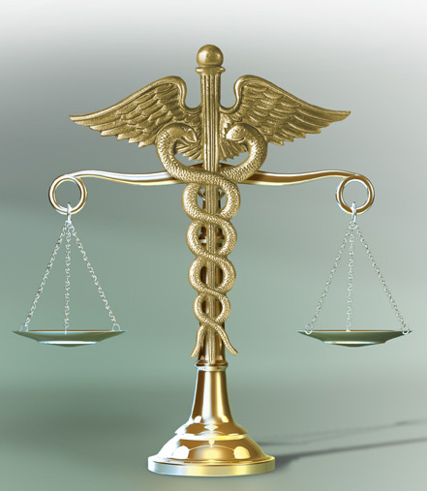
Conclusion
Further research:
Additional Interviews
Analyze housing-specific questions
Notes:
Expansion: referrals from insurance companies, referrals from specific programs (e.g. teen mothers program and asthma-specific programs; Emergency Departments)
As mentioned earlier – a lot of talk about EMRs and what’s the best way to get into those.
Insurance companies: From DC re Partnerships with a Medicaid Managed Care organization: They have an asthma quality improvement program to try to improve the care and decrease emergency room visits for kids with asthma. And so when there are housing conditions issues we take referrals from them to try to see if we can help on housing conditions part of it.
And, of course, research also brings up more questions… if I had more time I would look at what MLPs are doing at the advocacy level. One professional I talked to from DC participates in a housing policy advocacy group and she goes to a housing policy meetings. She’s working to get legislation passed in D.C. that would give tenants’ rights when there’s mold in the home. (Right now there’s no legal hook, so landowners can paint over mold.)
Cincinnati discovered that a number of their patients came specifically from one substandard housing cluster, so the attorneys worked….

