Slide 1
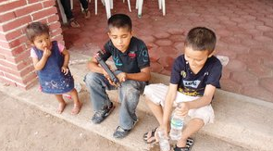
Violence against children and youth in Mexico: A Public Health Approach
Liliana Alcántara (El Universal)
Carolina de la Portilla, (MPH student, University of Munich)
Enrique Cifuentes (MD, PhD, mentor Harvard School of Public Health)

Slide 2
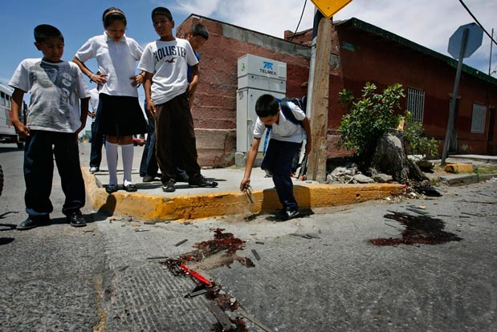
1. Background
Epidemic of interpersonal community violence in Mexico.
The homicide rate (per 100 000 pop.) increased from 8.4 in 2008 to 23.8 in 2010.
Children and youths as victims, witnesses and perpetrators.
Public Health:
Evidence-based preventative interventions.

Slide 3
Background
1. Background – Violence and Health
Short-term effects:
Physical injury
Increased mortality
Emotional distress
(PTSD, anxiety)
Long-term effects:
Disability
Mental illness
Behavioral change (Aggressive, risk-taking behavior)
Substance abuse

Slide 4
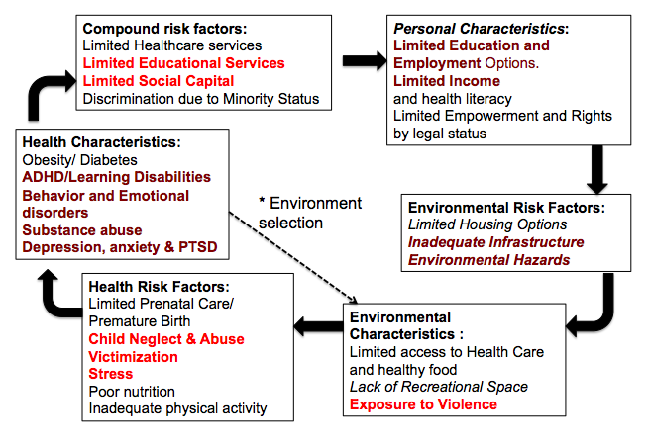
1. Background – Break the Cycle

Slide 5
Research questions
2. Research questions
Lethal interpersonal violence in Mexico.
2.1 Objective 1
Who and where?
Determine the regional and temporal trends
2.2 Objective 2
Identify specific risk factors
Do income inequality and other socio-economic indicators correlate with higher homicide rates?

Slide 6
Methods
3. Methods
3.1 Ecologic study
One geographical level (32 federal states)
3.2 Data sources:
National Institute of Statistics and Geography
CONAPO, CONEVAL
3.3 Indicator variable:
Intentional homicide rate (per 100 000)
Two age groups:
0 to 14 years old
15 to 24 years old

Slide 7
3. Methods
3.4 Descriptive analysis
Temporal and regional trends
Organize risk factors within a socio-ecologic framework.
3.5 Correlation analysis
Step-wise multiple logistic regression (backwards)
Socio-economic indicators:
GINI index
Avg. median income
Regional category
Illiteracy rate

Slide 8
4. Results - Temporal trends
Homicide rates between 2002 and 2012 by region
Male and female (15 to 24 years old)
World avg. in 2010 (6.6 per 100 000)
Source: INEGI, CONAPO, UNODC

Slide 9
Results
4. Results – Gender and age differences
National homicide rates in 2010 per gender and age group
Source: CONAPO, INEGI

Slide 10
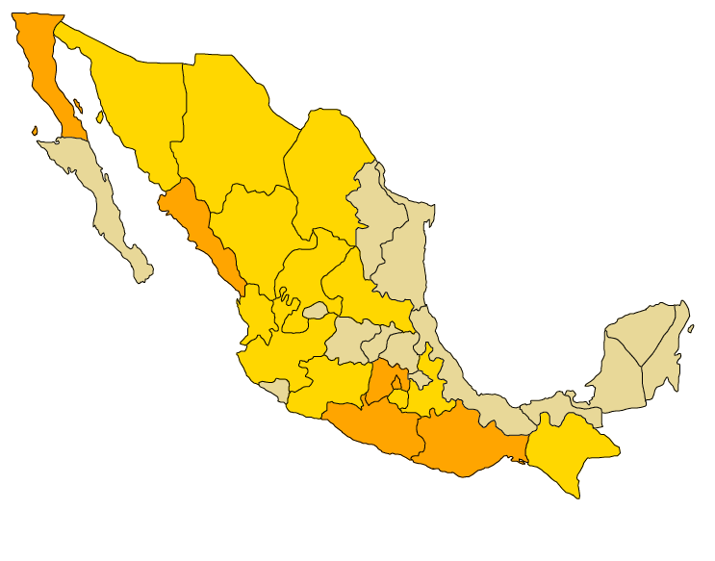
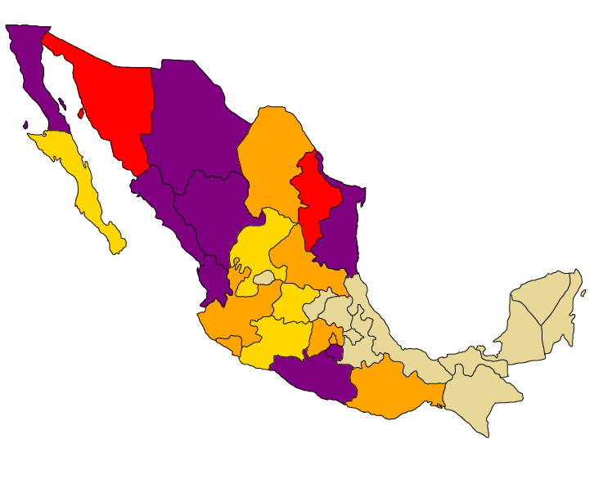
4. Results – Regional differences
Male homicide rates (aged 15 to 24)
2002
2010
0 -15.0
15.01 - 30.0
30.01- 45.0
45.01 - 60.0
>60.01
Source: INEGI, CONAPO

Slide 11
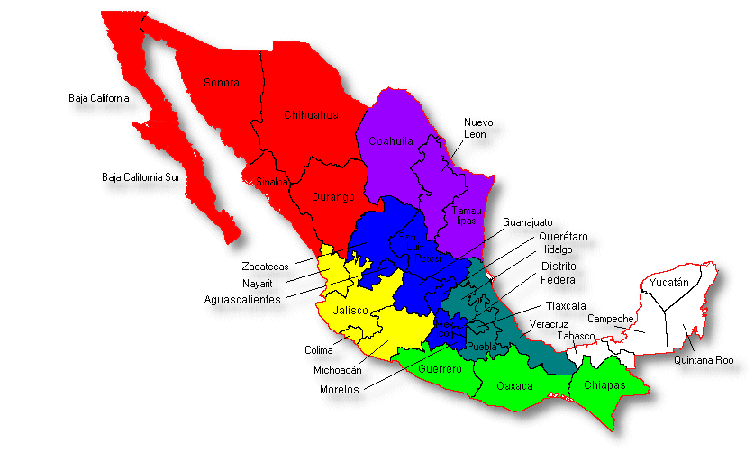
4. Results - Categorization
Regional categorization
Sub-region | Category
Northwest | 3.5
Northeast | 3
West | 2.5
North-central | 2
South-central | 2
East | 1.5
Southwest | 1
Southeast | 0.5

Slide 12
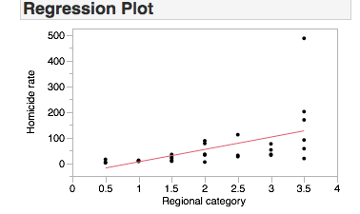
4. Results - Correlation analysis
Dependent variable: Male homicide rate (15 to 24)
Socio-economic indicator:
Regional category
p < 0.014*
Non significant: (GINI index, Illiteracy rate, avg. median income, population density)
R Square | 0.29
R Square (adj.) | 0.27

Slide 13
5. Conclusion
5.1 Interpersonal lethal youth violence continues to escalate
5.2 Most homicides occur among young males
(aged 15 to 24)
Involvement in criminal activity?
5.3 The most affected regions are in the Northwest and Northeast (violence continues to spread)
5.4 Lack of association between homicide rates and income inequality on THIS geographical scale.

Slide 14
6. Limitations
6.1 Ecologic study
Geographical scale: Federal states
Next steps: Municipalities and neighborhoods (underway!)
6.2 Official data (secondary)
6.3 Only considered lethal violence as an outcome.
Mental health?

Slide 15
Next steps
Need for the design and implementation of evidence-based interventions:
Generate reliable data.
Consistent monitoring AND evaluations
Targeting younger age groups
Multi-sectorial approach
How can we reduce the harmful effects of chronic exposure to violence?

Slide 16
Thank you!

